Slide 1
Geriatric Acetabular Fractures
Josh Namm, MD and Brian J Page, MD
August 24, 2024

Slide 2
Objectives
Discuss differences in acetabular fractures between adult and geriatric patients
Discuss fracture morphology
Discuss outcomes
Discuss treatment options and operative indications in geriatric acetabular fractures
Notes:
NEED NEW IMAGES

Slide 3
Introduction
Geriatric acetabular fractures have shown a steady increase over the past few decades
Low energy acetabular fractures are much more common in the geriatric population due to osteoporosis and falls
Although not entirely known, mortality rates for these injuries may be 16% or more

Slide 4
Introduction – Fracture Pattern
Fracture patterns may be unique that do not fit typical fracture classifications due to poor bone quality compared with younger patients
Most common patterns/findings:
  Anterior column posterior hemi-transverse
  Anterior column medial wall
  Quadrilateral surface fracture (protrusio)
  Fracture comminution more common
  Superior medial dome impaction (“Gull Sign”)
  Both column injuries common

Slide 5
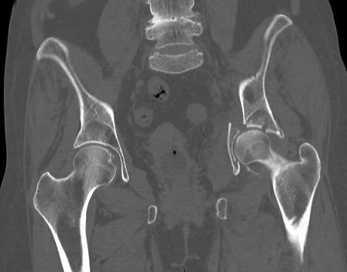
Gull Sign
Anglen et al. (JOT 2003)
  “Harbinger for failure”
  Superomedial dome impaction on preoperative radiographs predicted failure (termed “Gull Sign”)
Multiple techniques described
  [e.g. Laflamme et al. (JOT 2014)]

Slide 6
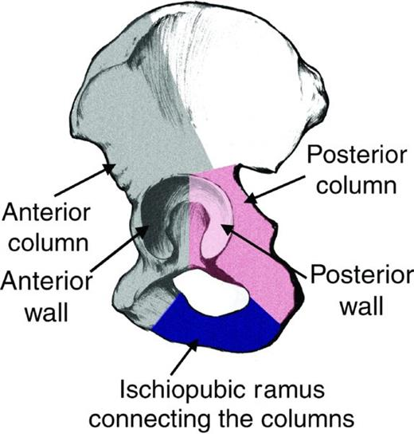
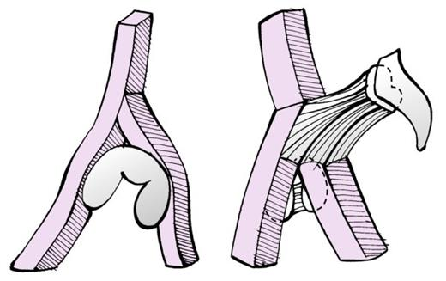
Classification – Letournel and Judet
Based on a “two column” structure
Moed BR, Bourdreau JA. Chapter 50. Rockwood and Greens Fractures in Adults. Philadelphia: Lippincott Wiliams & Wilkins, 9e, 2019
Notes:
Fig 50-7, 50-8

Slide 7
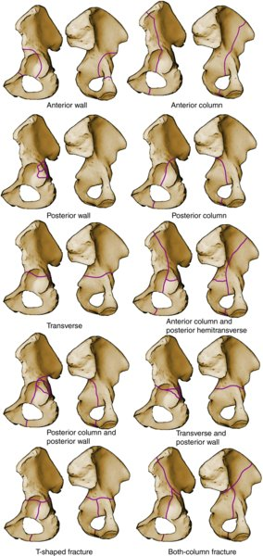
Classification – Letournel and Judet
5 elementary patterns
  Anterior wall
  Anterior column
  Posterior wall
  Posterior column
  Transverse
5 associated patterns
  Anterior column plus posterior hemitransverse
  Posterior column plus posterior wall
  Transverse plus posterior wall
  T-type fracture
  Both column (BC) fracture
Elementary Patterns
Associated Patterns
Moed BR, Bourdreau JA. Chapter 50. Rockwood and Greens Fractures in Adults. Philadelphia: Lippincott Wiliams & Wilkins, 9e, 2019
Notes:
Rockwood 50-15

Slide 8
History and Physical
Injury mechanism (typically GLF)
Pre-injury function/ambulatory status
Pre-existing hip/back pain
Current living status
Hemodynamic status
Medical comorbidities (including anticoagulant use)
Complete LE NV exam
Examine pelvis for open wounds, blood at urogenital meatus/rectum
Leg length
SI joint TTP
Motion pain/instability

Slide 9
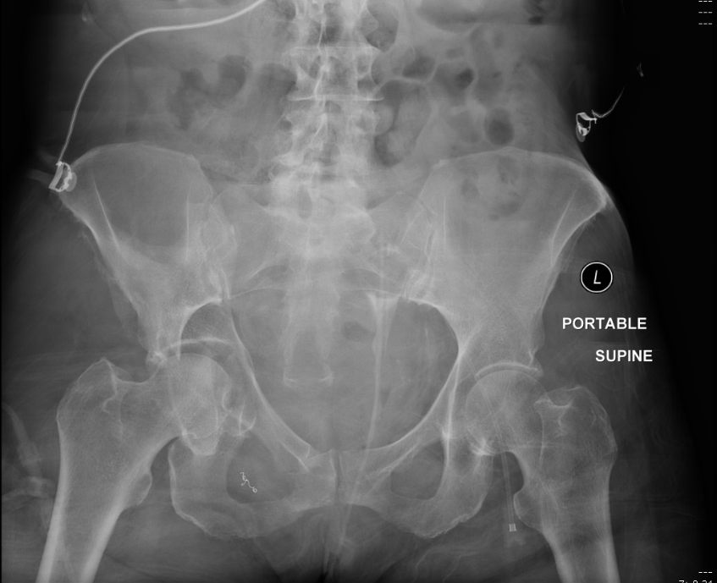
Special Considerations
Early mobilization is an important goal to keep in mind
Pre-existing hip pain/degenerative joint disease
THA combined with ORIF
Notes:
Poor bone quality leads often to protrusion, medial dome impaction

Slide 10
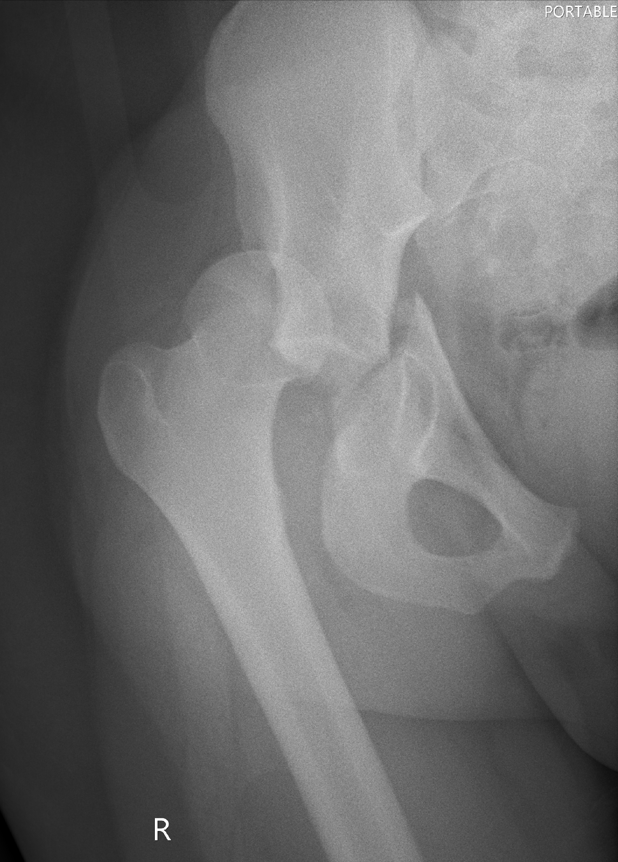
Operative Indications
Controversial
  Significant variation among centers for operative vs nonoperative tx
Relative Indications:
  Displacement > 2 mm in the weight bearing dome
  Hip instability
  Congruency
  Femoral head impaction
Other considerations:
  Comorbidities
  Functional status
Notes:
Indications for surgery 2 mm displacement WB dome and instability/incongruency

Slide 11
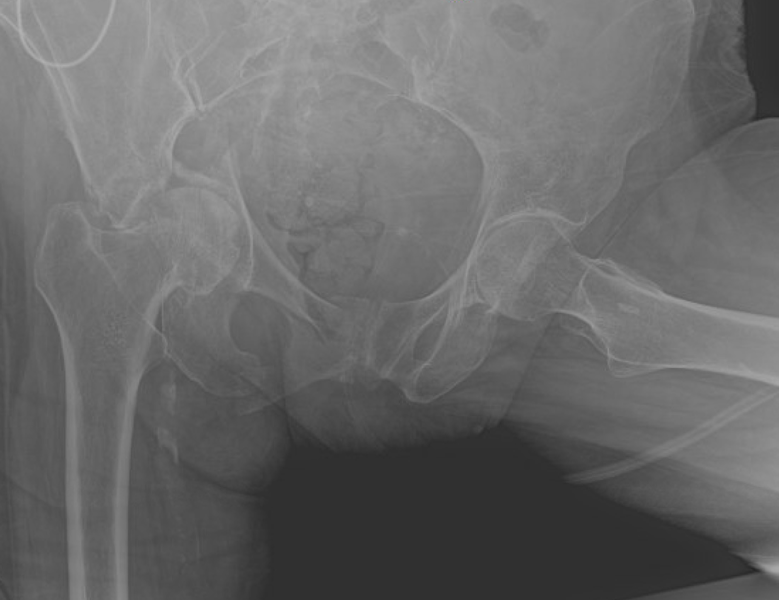
Secondary Congruence
Common in both column injuries
Maybe managed nonoperatively in certain instances (i.e. non-operative candidates, low-demand)
May consider late THA if persistent pain

Slide 12
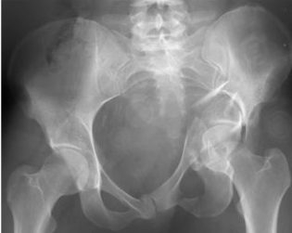
Secondary Congruence
Both column acetabular fracture with secondary congruence (left hip in XR)
Levine et al. (JOT 2002)
  Secondary congruence does not produce an acetabulum equal to the prefracture state
    Decreased anterior and posterior surface contact area
    Increased contact pressures in the acetabular dome on either side of fx gap
Despite these biomechanical findings small series show good outcomes at medium to long term follow up with secondary congruence
Notes:
Rockwood and Green Fig 50-31A

Slide 13
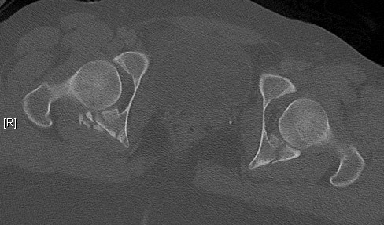
Hip Stability in Posterior Wall (PW)
Posterior wall (PW) fracture being considered for non-op
  Examination Under Anesthesia (EUA) – Gold standard (assesses hip stability)
EUA
  Exam performed with pt supine
  Live fluoroscopy used during examination
  AP and obturator oblique x-rays used for examination with c-arm on same side as examiner
  Hip placed in flexion and adduction during exam with axial load applied to femur
  Instability diagnosed with any subluxation of femoral head
Notes:
EUA may be needed for indeterminate stability PW fx’s

Slide 14
Nonsurgical Treatment
Indications:
Stable hip
Congruent hip/secondary congruency
Fracture outside of weightbearing dome or <2mm of displacement inside of weightbearing dome
*Indications are controversial.
Treatment:
Toe-touch weight bearings (TTWB) versus Weight-bearing as tolerated (WBAT)
  TTWB results in lower joint reactive forces than non-weight bearing (NWB)
Posterior hip precautions with PW fractures
Consider DVT prophylaxis
Notes:
Hip must be stable with congruency for nonsurgical tx

Slide 15
Non-Operative vs Operative Considerations
Ryan et al. (JOT 2017)
Patients ≥60 years had surprisingly good outcomes with non-operative treatment
1 year mortality rate 24%
Conversion of treatment occurred in 15% (i.e. ORIF, THA)
Manson et al. (JOT 2016)
Significant variation among centers for operative vs nonoperative treatment
Variables associate with Operative Tx
  Age <80 years
  High energy mechanism
  Femoral head impaction
  Lack of hip congruency
88% received ORIF, 12% THA as initial tx

Slide 16
Non-Operative vs Operative Considerations
Gary et al. (JOT 2015)
No significant difference in hazard of death in non-op versus operative treatment when comorbidities were considered
Age >70 resulted in increased hazard death 1.08/year in the group as a whole
Associated fracture patterns significantly increased the hazard of death 1.51
O’Toole et al. (JOT 2014)
1 year mortality rate was 25% for ORIF
28% rate of conversion to arthroplasty
  Average of 2.5 years from injury
Delayed THA functional scores were similar to elective arthroplasty
Failure rate of those with PW component was 2x that of those without PW

Slide 17
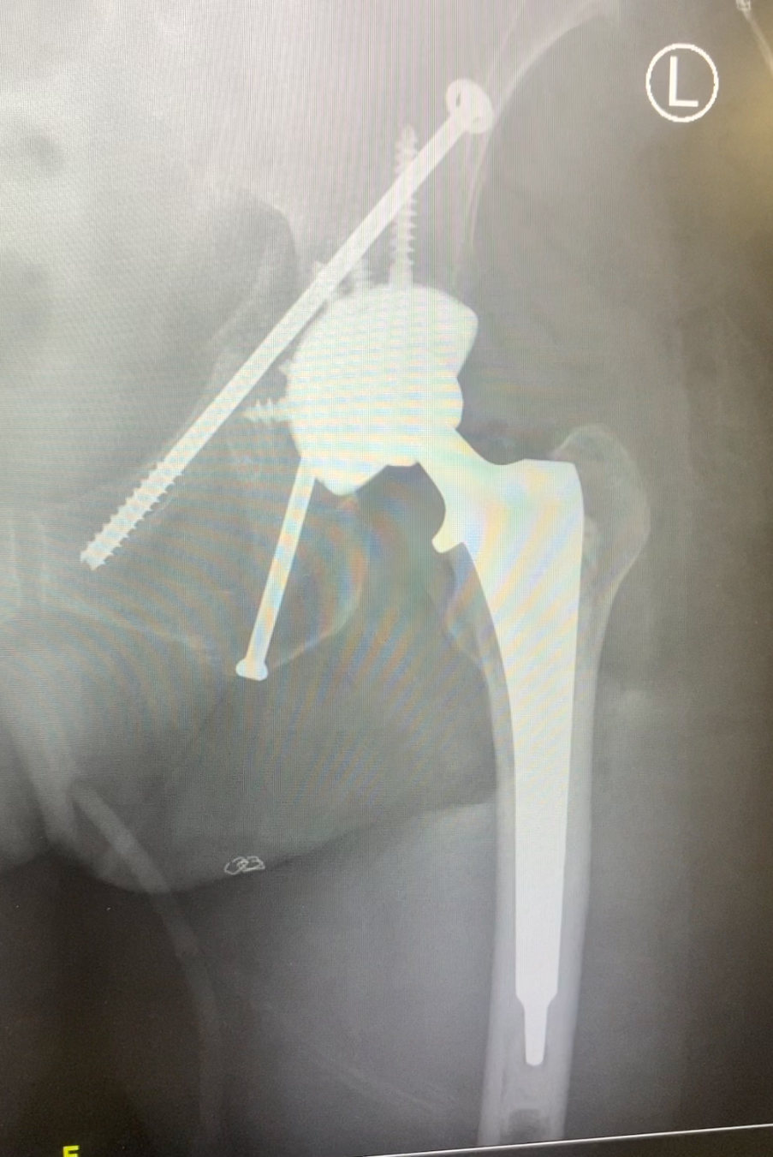
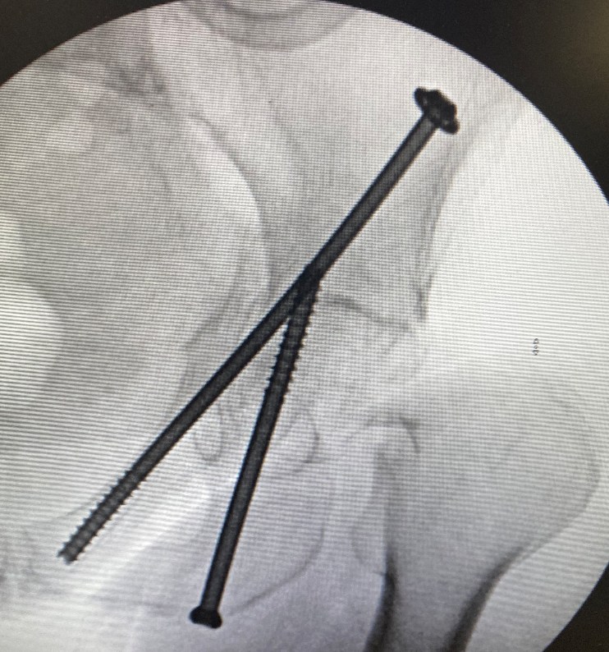
Operative Treatment
Percutaneous
Open reduction internal fixation (ORIF)
Combined THA
  Perc + THA
  ORIF + THA
Notes:
Time to surgery not a/w survival
Minimally invasive techniques did not change outcome scores or conversion rates to THA, similar mortality

Slide 18
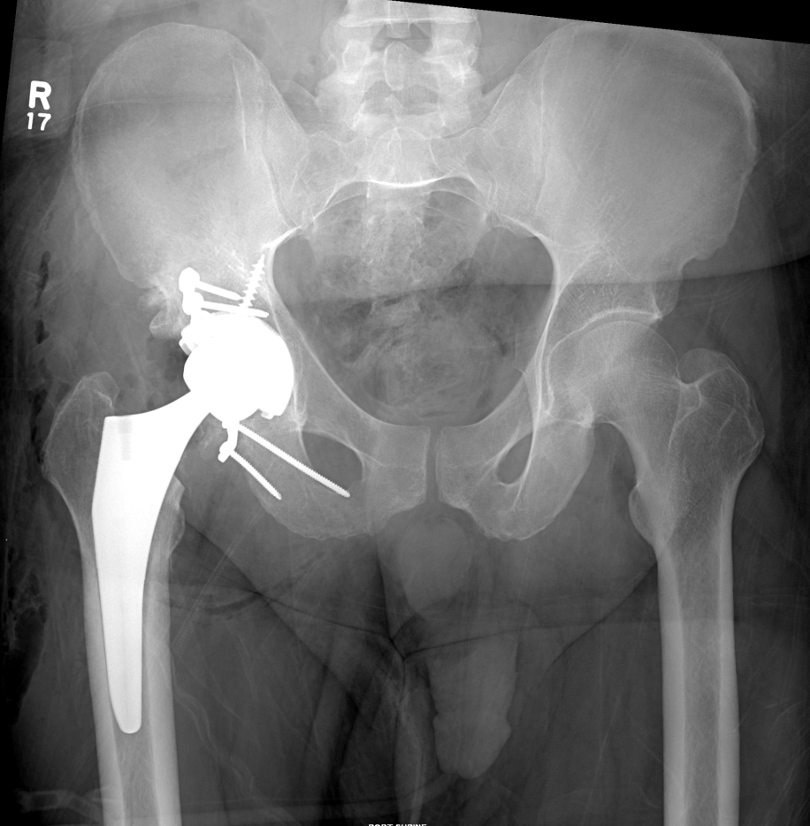
Combined THA
Consider in cases with:
  Pre-existing arthritis
  Severe articular cartilage damage
  Concurrent femoral head or neck fracture
  Marginal impaction
  Superior dome impaction

Slide 19
Outcomes
Bible et al. (JOT 2014)
Mortality rates are lower in elderly patients with isolated acetabular fractures than in those with concurrent injuries to other organ systems, long bone fx, or pelvic ring fx
One year mortality rate (avg age 71.1 yrs) was 8.1%
23.3% mortality in nonisloated group
When considering only patients who survived initial hospitalization, mortality similar between groups
Trend toward higher mortality in nonop tx in isolated fxs
Notes:
23.3% mortality in acetabular fx combined with other injuries

Slide 20
Outcomes
Glogovac et al. (JOT 2020)
183 pts 65 years and older treated operatively
1 year mortality 15%
No difference in mortality when surgical intervention within or after 48 hours
Increased mortality independently associated with advancing age
Gary et al. (JOT 2012)
No differences between percutaneous fixation and ORIF in conversion to THA
1 year mortality 13.9%
Notes:
Time to surgery not a/w survival
Minimally invasive techniques did not change outcome scores or conversion rates to THA, similar mortality

Slide 21
Summary
Fracture patterns may be atypical due to poor bone quality compared to younger patients with acetabular fractures
Lower energy injuries that are more comminuted with more impaction and quadrilateral surface involvement
Surgical indications are controversial
  Must consider functional status, comorbidities, age, congruency, and stability.
Operative treatment includes percutaneous, ORIF, and combined THA
1 year mortality is high
ORIF combined with THA more often utilized as treatment in geriatric acetabular fractures

Slide 22
References
Gary JL, Paryavi E, Gibbons SD, et al. Effect of surgical treatment on mortality after acetabular fracture in the elderly: a multicenter study of 454 patients. J Orthop Trauma. 2015;29(4):202-208.
O’Toole RV, Hui E, Chandra A, Nascone JW. How often does open reduction and internal fixation of geriatric acetabular fractures lead to hip arthroplasty? J Orthop Trauma. 2014;28(3):148-153.
Ryan SP, Manson TT, Sciadini MF, et al. Functional outcomes of elderly patients with nonoperatively treated acetabular fractures that meet operative criteria. J Orthop Trauma. 2017;31(12):644-649.
Manson TT, Reider L, OʼToole RV, et al. Variation in treatment of displaced geriatric acetabular fractures among 15 level-i trauma centers. J Orthop Trauma. 2016;30(9):457-462.
Firoozabadi R, Spitler C, Schlepp C, et al. Determining stability in posterior wall acetabular fractures. J Orthop Trauma. 2015;29(10):465-469.
Riehl J, Koval K, Langford J, Munro M, Haidukewych G. Examination under anesthesia for posterior wall acetabular fracture a survey of the ota membership. Bull Hosp Jt Dis (2013). 2016;74(2):124-129.
Bible JE, Wegner A, McClure DJ, et al. One-year mortality after acetabular fractures in elderly patients presenting to a level-1 trauma center. J Orthop Trauma. 2014;28(3):154-159.
Glogovac G, Le TT, Archdeacon MT. Time to surgery and patient mortality in geriatric acetabular fractures. J Orthop Trauma. 2020;34(6):310-315.
Gary JL, VanHal M, Gibbons SD, Reinert CM, Starr AJ. Functional outcomes in elderly patients with acetabular fractures treated with minimally invasive reduction and percutaneous fixation. J Orthop Trauma. 2012;26(5):278-283.
Laflamme GY, Hebert-Davies J. Direct reduction technique for superomedial dome impaction in geriatric acetabular fractures. J Orthop Trauma. 2014;28(2):e39-43.
Anglen JO, Burd TA, Hendricks KJ, Harrison P. The “Gull Sign”: a harbinger of failure for internal fixation of geriatric acetabular fractures. J Orthop Trauma. 2003;17(9):625-634.
Levine RG, Renard R, Behrens FF, Tornetta P. Biomechanical consequences of secondary congruence after both-column acetabular fracture. J Orthop Trauma. 2002;16(2):87-91.

