Slide 1
Physical Exam of the Spine
What are the challenges to rule out: hand, shoulder, hip,SI joint pathology
Zack Wilt, MD
William Neway, DO

Slide 2
Spine Masqueraders
Hand numbness/weakness
Shoulder pain
SI joint pain
Hip pathology
Notes:
NEED NEW IMAGES

Slide 3
Ulnar Neuropathy or C8-T1?
C8-T1 radiculopathies are much less common than ulnar neuropathy
EMG and NCS may help confirm peripheral neuropathy or cervical radiculopathy after physical exam
  However, EMG and NCS have low sensitivity and specificity
    Ashkan et al. (British Journal Neurosurgery 2002) found 42% sensitivity and 40% specificity in diagnosing cervical radiculopathy
    Physical exam is an important for correct diagnosis
Notes:
NEED NEW IMAGES

Slide 4
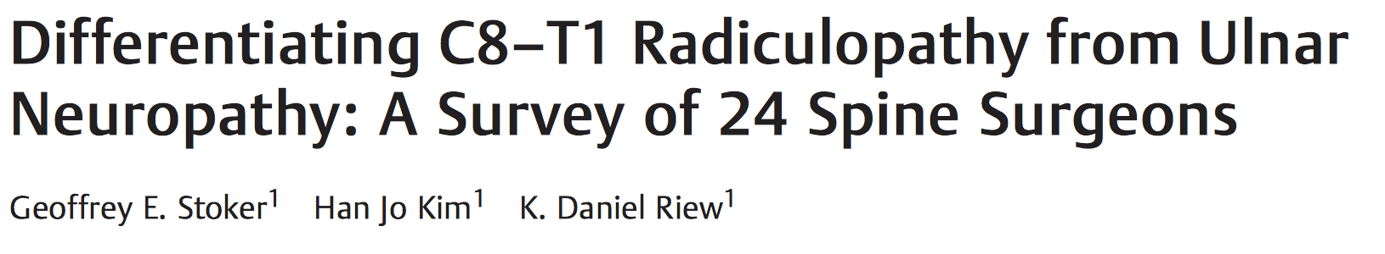
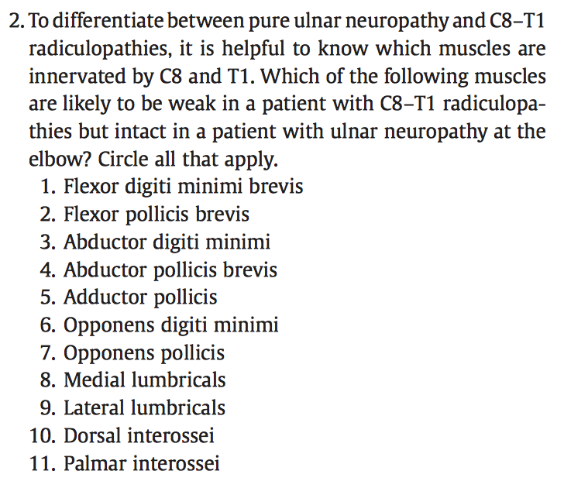
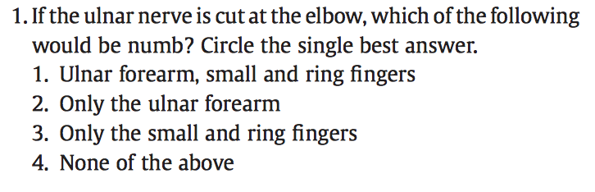
Ulnar Neuropathy or C8-T1?
Survey given to 33 experienced spine surgeons at national meeting for complex cervical spine surgery; 24 completed the survey
Notes:
Results: 15/24 (63%) correctly answered C
0 correctly identified all 5 muscles

Slide 5
Ulnar Neuropathy or C8-T1?
15/24 (63%) correctly answered #3.
0 correctly identified all muscles.
Notes:
NEED NEW IMAGES

Slide 6
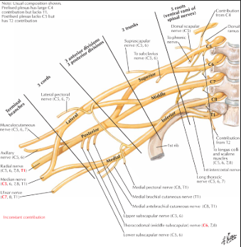
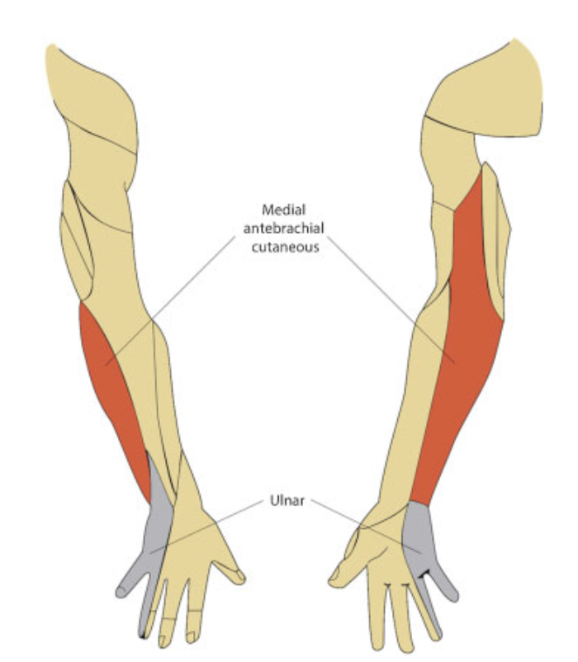
Sensory
Ulnar nerve provides sensation to 4th and 5th fingers and medial border of the hand
Medial antebrachial cutaneous nerve provides sensation to medial forearm (via C8-T1 roots and medial cord of the plexus)
Ulnar lesion at elbow = numbness in ulnar hand and 4th and 5th fingers.
*If symptoms in hand only, then ulnar nerve. If symptoms radiating down the arm, more likely related to neck.
Notes:
Therefore, an ulnar lesion at the elbow—a com-mon site of compression or trauma—would result in anesthe-sia of the ulnar hand andfingers but not the forearm.

Slide 7
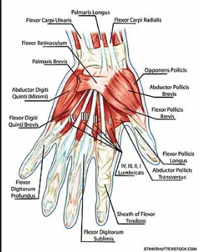
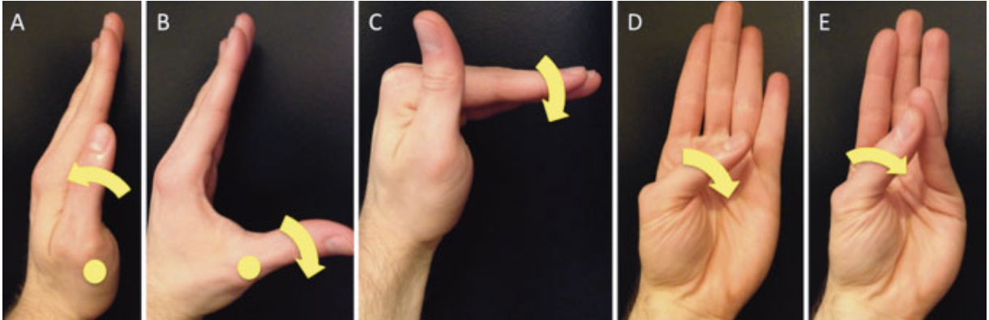
Motor
Ulnar nerve innervates all intrinsic hand muscles except: (mnemonic LOAF)
- Lateral 2 lumbricals
- Opponens P
- Abductor PB
- Flexor PB
- -
Abductor Pollicis Brevis
Lumbrical
Opponens Policis
Notes:
The abductor andflexor pollicisbrevis, opponens pollicis, and lateral two lumbricals areinnervated by C8–T1 via the median nerve, entering thehand through the carpal tunnel
The abductor andflexor pollicisbrevis, opponens pollicis, and lateral two lumbricals areinnervated by C8–T1 via the median nerve, entering thehand through the carpal tunnel.13The mnemonicAbOF theLawmay be useful—the abductor (Ab) andflexor (F) pollicisbrevis, opponens pollicis (O), and lateral lumbricals (Law) are“above the law”that intrinsic hand muscles are ulnar-inner-vated. By specifically examining thesefive muscles (►Fig. 3),one can differentiate between cubital tunnel syndrome,which leaves their motor strength intact, and C8–T1 radicu-lopathies, which would result in weakness. For example, theabductor pollicis brevis elevates the thumb about the meta-carpophalangeal joint to 90 degrees relative to the plane ofthe palm (►Fig. 3B). Its strength is tested by the examinerattempting to adduct the thumb into the same plane as, orparallel to, the palm. The lumbricals engenderflexion at themetacarpophalangeal joints and extension at the interpha-langeal joints (►Fig. 3C). Theflexor pollicis brevis bends thethumb at the metacarpophalangeal joint in approximately thesame plane as the palm (►Fig. 3D), and the opponens allowsthe thumb to contact thefifthfinger (►Fig. 3E). Last, despitethese canonical motor innervation patterns, the possibility ofanomalous median-ulnar neural pathways such as a Riche-Cannieu or Martin-Gruber anastomosis should be kept inmind.14,15

Slide 8
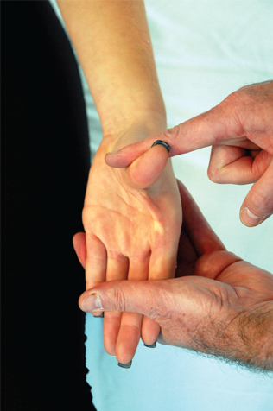
Simple test to strength thenar muscles strength all at once:
Ask patient to hold the thumb out in front and push down.
Weakness = C8-T1 radiculopathy
Notes:
NEED NEW IMAGES

Slide 9
Carpal Tunnel Syndrome

Slide 10
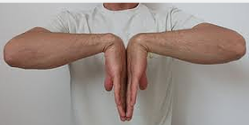
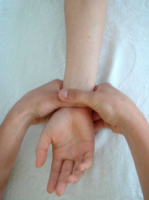
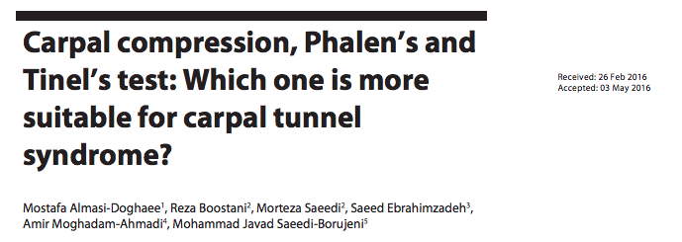
Carpal Tunnel Syndrome: Commonly Confused Tests
Carpal Compression Test
  Sensitivity 80.6%, specificity 52.9%
Phalens Test
  Sensitivity 59.7%, Specificity 35.3%
Hoffman-Tinel Test
  Sensitivity 65.3%, Specificity 47.1%
Phalen’s Test
Carpal Compression Test
(aka Durkan’s Test)
Notes:
NEED NEW IMAGES

Slide 11
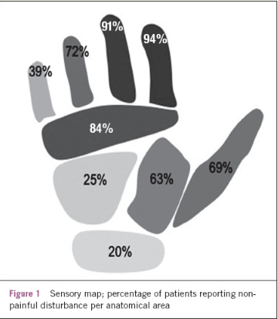
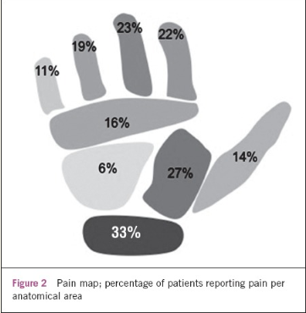
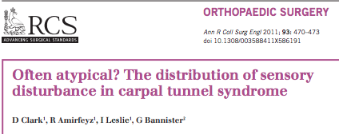
Clinical Findings
Sensory
Pain
Weakness / atrophy of abductor pollicis brevis is useful but likely only found late in disease
  No weakness in C6 distribution – Biceps, wrist extension
Pain and Numbness
  But where?
Notes:
NEED NEW IMAGES

Slide 12
Why don’t symptoms fit the “Anatomy”
Patient’s interpretation
Neurologic Variants
  Pre/Post-fixed brachial plexus
  Martin-Gruber anastomosis
  Rich-Cannieu anastomosis
  Berretini anastomosis
Notes:
Pre-fixed – 25-40% have large C4 contributions
Martin gruber – incidence 5-34%, most common is type 1 – median nerve travels on ulnar nerve, crosses back from ulnar to median in forearm, innervates thenar +/- ulnar intrinsics
Rich-cannieu – up to 50%, deep branch of ulnar nerve traverses adductor to communicate with thenar motor branch of median nerve
Berettini – up to 80% - palmar communicating (sensory) branches between median and ulnar nerves, distal to TCL

Slide 13
Shoulder Pathology

Slide 14
Cervical Spine vs. Shoulder Pathology
Shoulder
dull ache
night time pain (laying on it)
Worsens with activity
Worsens with arm abduction
Spine
burning/electric
Improves with arm abduction
Worsens with neck deviation
Valsalva worsens
Notes:
NEED NEW IMAGES

Slide 15
Distinguishing Physical Exams
Shoulder
Hawkins and Neer tests for impingement syndrome
Painful arc on ROM
Jobe’s Test/Drop Arm test
O’Brien’s Test
Bicipital Groove Tenderness
Spine
Spurling’s Test
Arm Abduction Test
Neck Distraction Test
Notes:
NEED NEW IMAGES

Slide 16
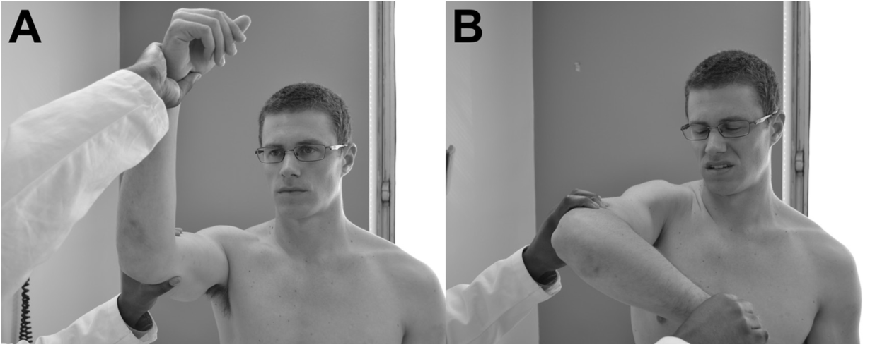
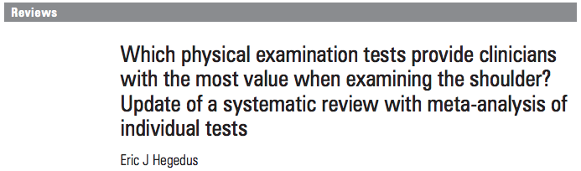
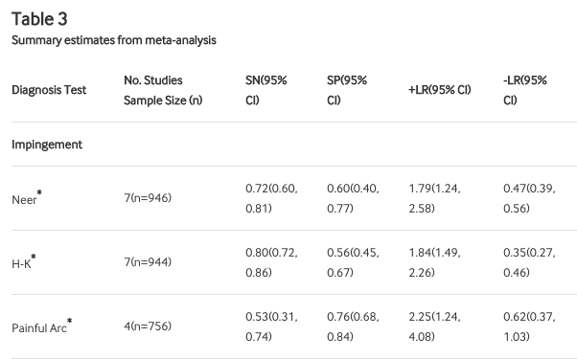
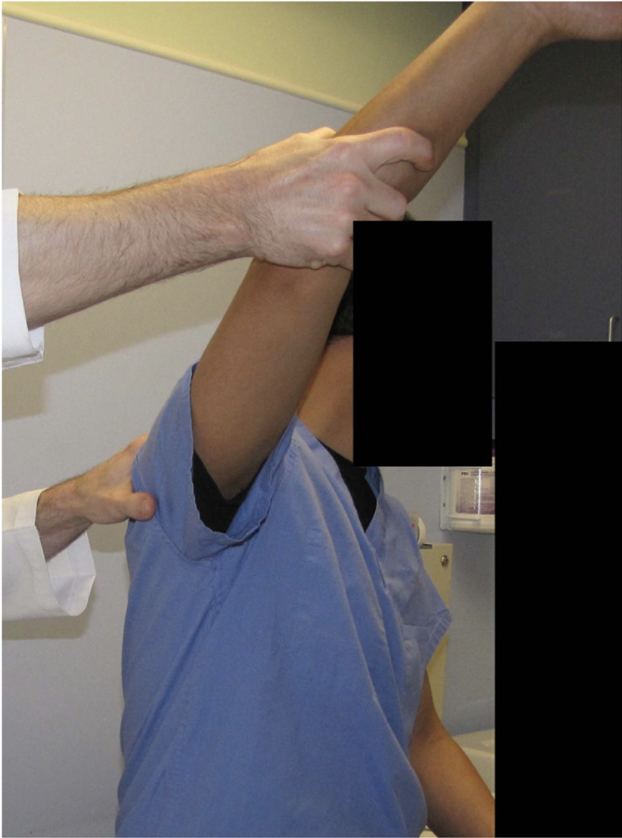
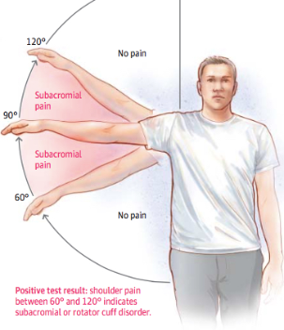
Value of Shoulder Tests - Impingement
Hawkins-Kennedy
Painful Arc
Neer’s
Notes:
NEED NEW IMAGES

Slide 17
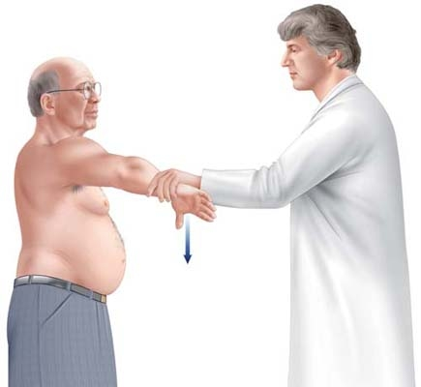
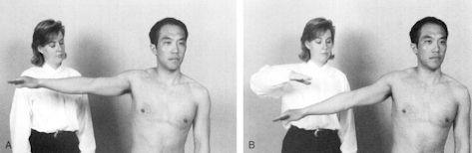
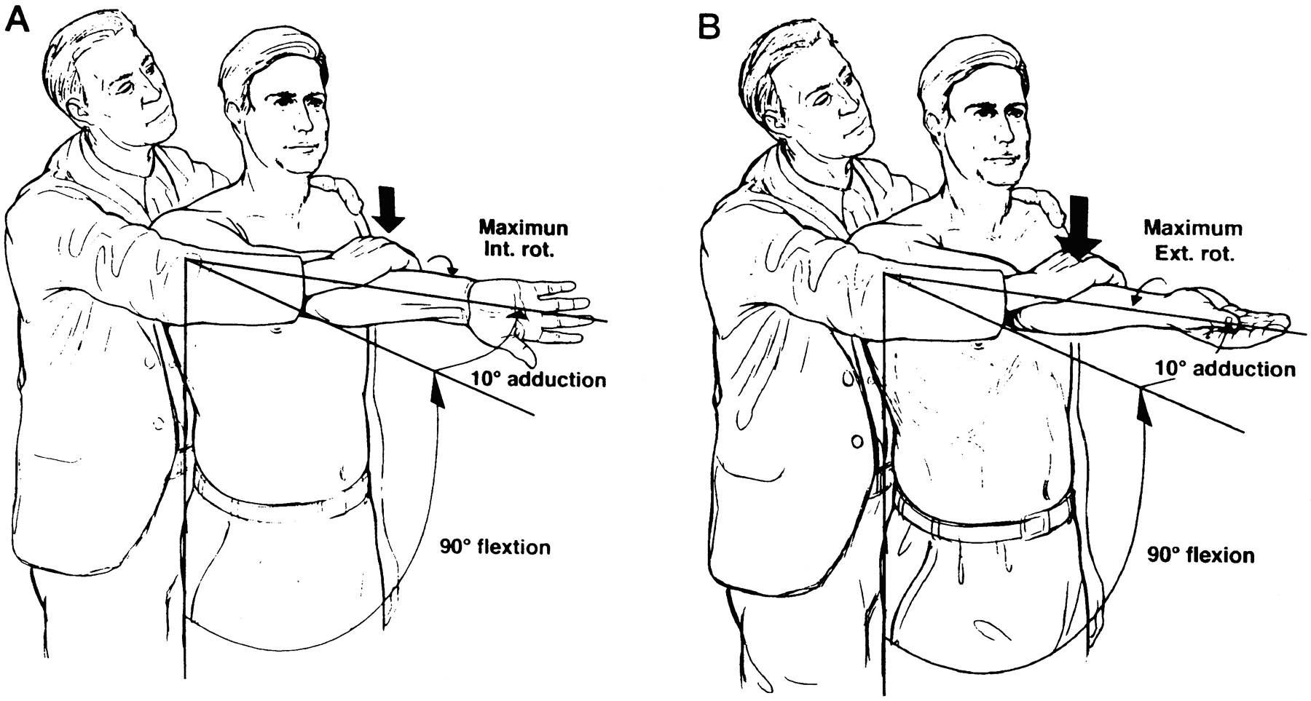
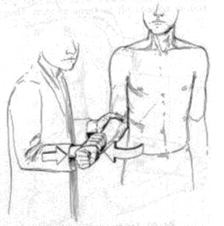
Drop Arm test
Jobe’s test
(supraspinatus)
O’Brien’s Test (Biceps Tendon/Slap Tear)
ER test
(infraspinatus)
Notes:
NEED NEW IMAGES

Slide 18
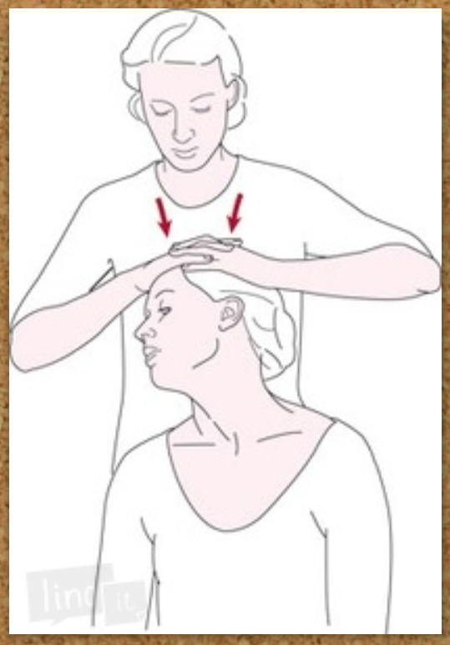
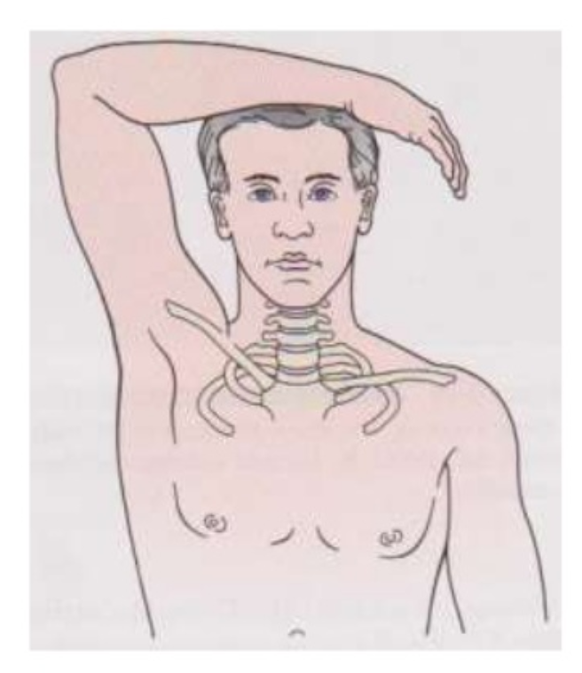
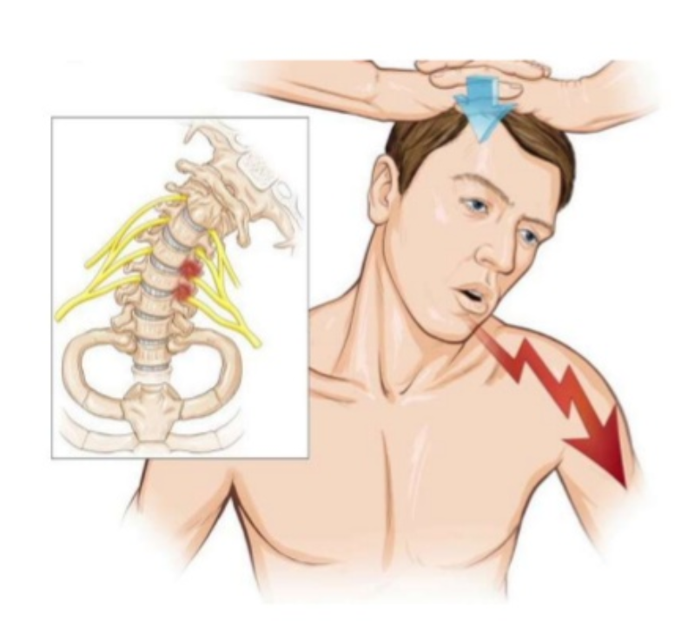
Original Spurling’s Test
(lateral bending and compression)
Accepted Spurling’s Test
(extension/compression and rotation towards affected side)
Shoulder Abduction Sign
Notes:
NEED NEW IMAGES

Slide 19
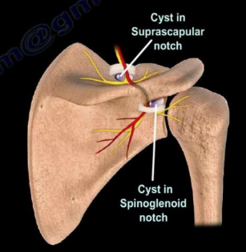
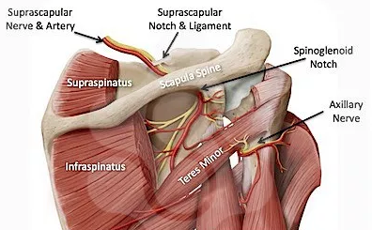
Shoulder vs. Radiculopathy
Rotator Cuff Tear
Weakness in supra +/- infra
Remainder of cuff normal (subscap)
Other C5 and C6 muscles normal
Normal bicep test*
Normal sensation
Suprascapular nerve pathology
Suprascapular notch cyst
-Weakness in supra and infra
Spinoglenoid notch cyst
-Weakness in infra
C5 radiculopathy
Weakness in supra and infra
Weakness in subscap and teres
Other C5 muscles weak – deltoid/bicep
Positive bicep tests (weakness)
Abnormal sensation
Notes:
NEED NEW IMAGES

Slide 20
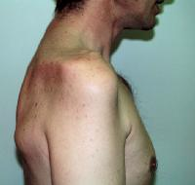
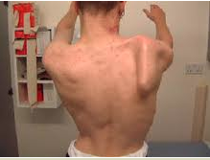
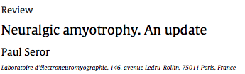
Parsonage-Turner (aka Brachial Neuritis, Neuralgic Amyotrophy)
Looks very similar to cervical radiculopathy
  Affects upper roots/trunks/cords (~C5-6)
Rare? Incidence reported between 1/1000 and 100,000
Pain (1d to 2mths) is first symptom in 90%, commonly at night
  Diffuse shoulder, extending to neck and upper arm
  30-70% may have residual pain after initial “painful phase”
Weakness and sensory complaints
  Sensory complaints 66-78%
  Weakness within 24hr of pain in 34%, 1-7d in 39%,
  Wasting (amyotrophy) seen at 2-6 weeks
  Most commonly affected
    Infraspinatus 72%
    Serratus anterior 70% (medial scapular winging)
      innervated by Long Thoracic Nerve (C5-C7)
    Supraspinatus 65%
    Biceps 61%
Notes:
Incidence reported between 1/1000 and 100,000, asymmetric in 97%
75% good to complete recovery by 6 to 36 months

Slide 21
LOWER EXTREMITY

Slide 22
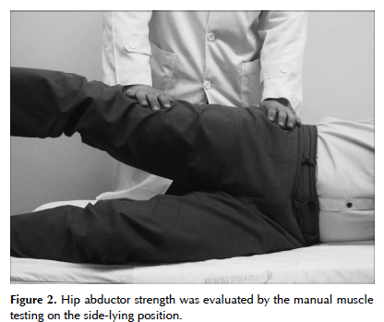
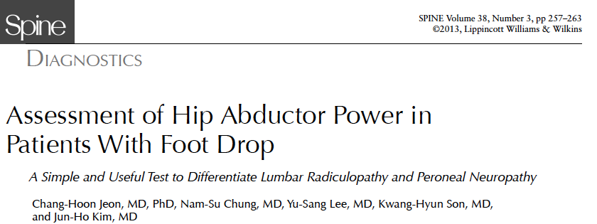
Foot Drop - Radiculopathy or Peroneal Neuropathy
Hip abduction weakness (<3/5) found in 18/21 patients with spinal etiology of foot drop
  L5 supplies gluteus medius, minimus, and tensor fascia lata
May also present with both trendelenberg and steppage gait

Slide 23
HIP AND GROIN PAIN
Notes:
Groin, anterior, or posterior hip pain. Can also be in buttock. It can worsen with prolonged sitting, rising from a seat, getting into or out of a car, or leaning forward. Pain is usually gradual and progressive.

Slide 24
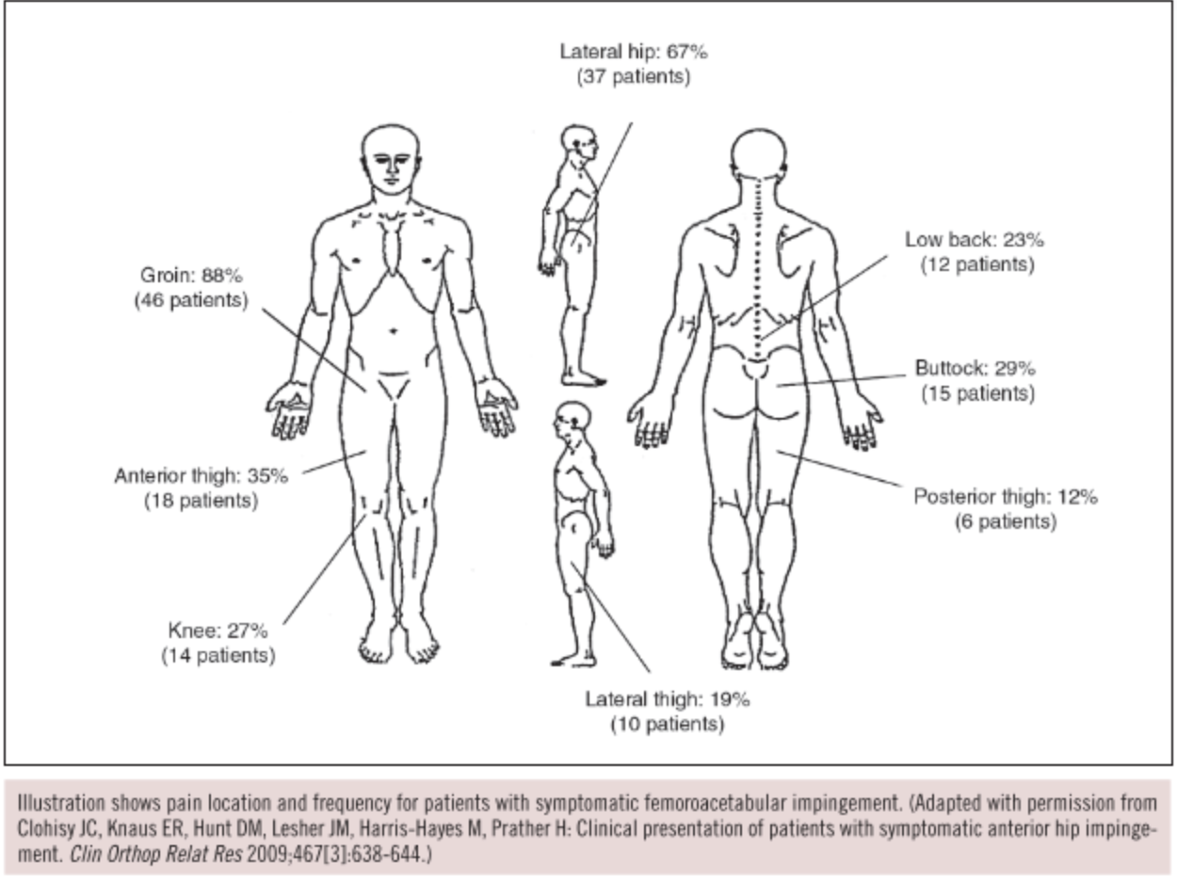
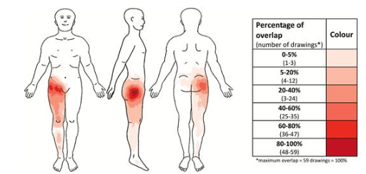
Intra-articular hip pathology pain diagrams
Femoroacetabular impingement
Hip DJD

Slide 25
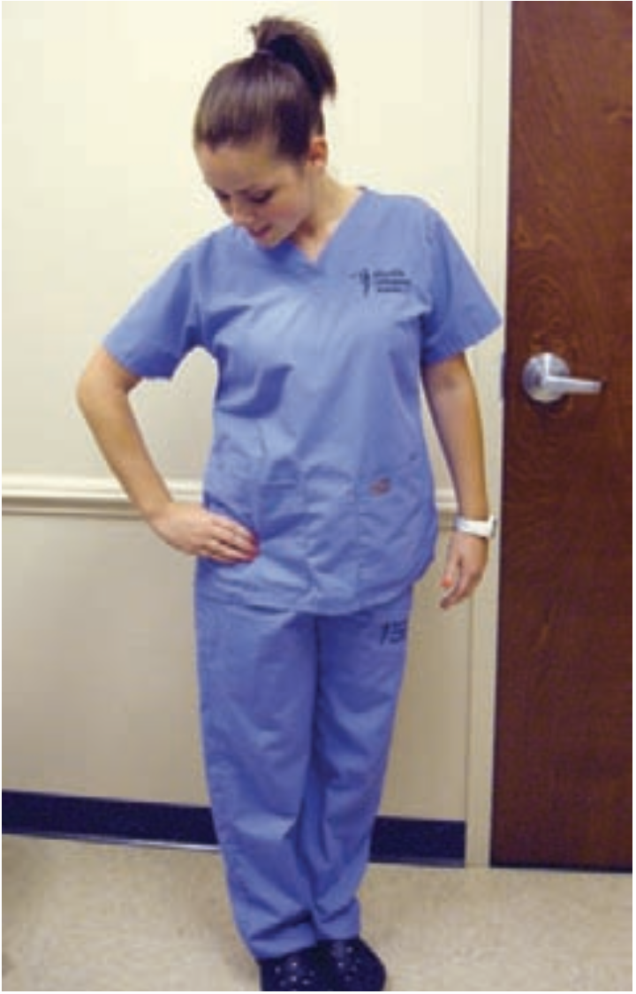
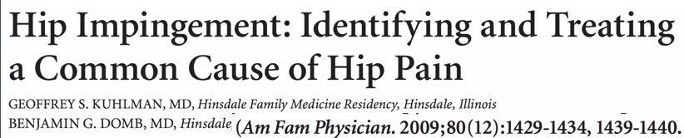
Hip DJD and FAI: C-Sign
Cupping thumb and index finger around hip in shape of letter C

Slide 26
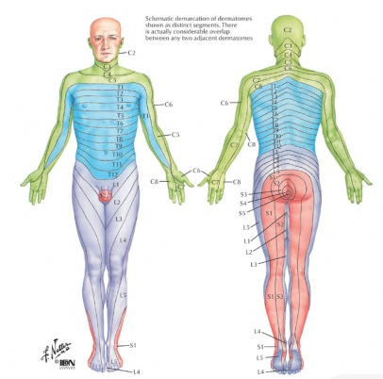
Spinal Causes of Anterior Thigh/Hip pain

Slide 27
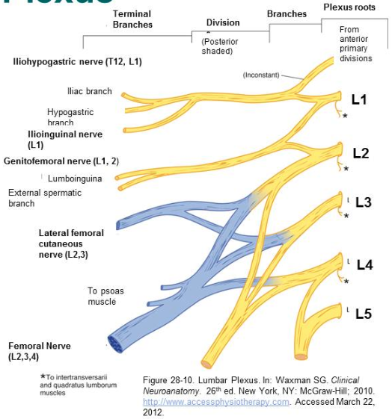
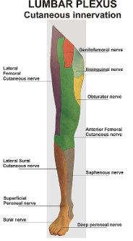
Obturator n (L2-4)

Slide 28
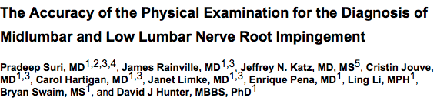
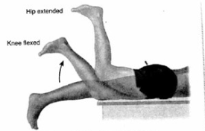
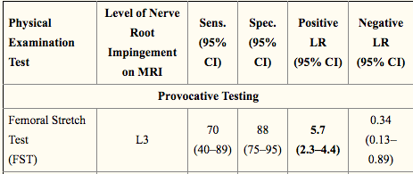
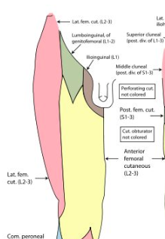

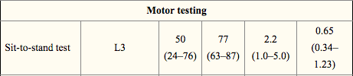

Slide 29
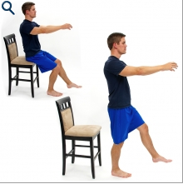
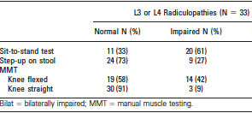

L3/L4 radiculopathy?
33 patients with confirmed L3 or L4 radiculopathy, no hip/knee symptomatic OA
Straight leg MMT only found weakness in 9%
Sit-to-stand identified weakness in 61%

Slide 30
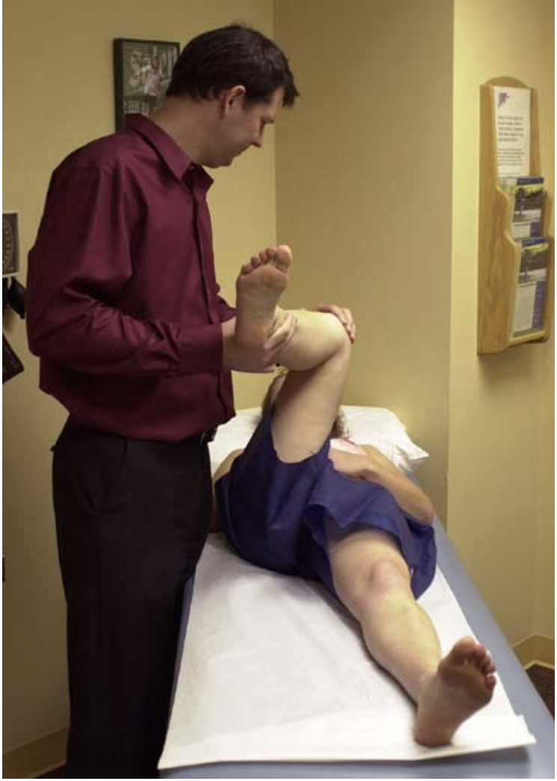
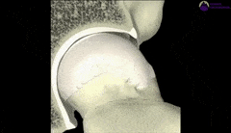
Provocative Maneuvers: FADIR
Flexion ADduction Internal Rotation
Flexion to 90, then Adduction + Internal Rotation
Positive if reproduces pain -
  Dynamic maneuver will elicit sx in labral tears
Excellent screening test
  94-99% sensitivity for FAI / labral tear
Notes:
Pmid 25515771

Slide 31
Hip Osteoarthritis Clinical Practice Guidelines
American College of Rheumatology – Clinical Prediction Rules for OA on hip exam
  Clinical findings
    Age >50
    Hip flexion less than 115 degrees
    Hip IR < 15 degrees
      Or if IR >15 degrees, then pain w/ IR and morning stiffness >60 minutes
  Sensitivity 86%, Specificity 75%

Slide 32
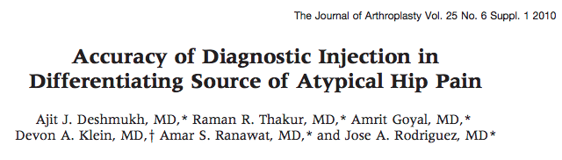
204 patients with atypical hip pain underwent IA injection
  Pain in hip region w/o radiating knee pain for >6mths, subtle XR degenerative changes in hip, known lumbar arthritis, absence of localizing exam findings
152 Patients (74.5%) with >50% improvement with injection
  91% sensitivity, 100% sensitivity for good outcome following THA
52 patients with <50% improvement
  34 patients underwent treatment of lumbar pathology with good results

Slide 33



Flexion Contractures
66 Female with back pain and fatigue s/p L3-5 PSF
Minimal improvement postop
Found to have sagittal imbalance

Slide 34

S/p L1-S1 PSF, with multiple PCO
No improvement
Still sagittal imbalance
…why?

Slide 35

…Oops
Complete improvement after THA

Slide 36



Thomas Test
Negative test
Positive test
Notes:
The patient holds the unaffected leg flexed while attempting to lower the affected leg to the table. An inability to lower the affected leg constitutes a positive test, indicating iliopsoas contracture.

Slide 37




Lateral hip pain - Ober Test
Neutral Testing
-Gluteus Medius contracture or tear
Extension Testing
-TFL contracture
Flexion Testing
-Gluteus Maximus Contracture
Notes:
The Ober test consists of three parts: extension, neutral, andflexion (Fig. 4.11). To perform the extension test abduct theaffected leg and extend it at the hip while flexing the ipsilat-eral knee. When allowing the leg to fall, note if the leg adductsimmediately or if a slight pause or any difficulty in adductionoccurs. To perform the neutral test, abduct the leg while theknee is flexed but the hip is in the neutral position, and thenallow the leg to fall into adduction. To perform the flexiontest rotate the torso to lay both shoulders on the table whileboth legs are still in the lateral position. Abduct the unaffectedleg with the knee fully extended and the hip flexed, and thenallow the leg to fall into adduction. In all three tests, the exam-iner abducts the leg in the specific position and then releasesthe leg. If the leg maintains its abducted position longer thanexpected, the Ober test is positive. A positive extension Obertest indicates tensor fascia lata contracture, while a positive neu-tral test indicates gluteus medius contracture or tear. A positiveflexion test indicates gluteus maximus contracture.

Slide 38


Posterior Hip Pain – FAI Posterior Impingement
Posterior hip impingement
Let leg hang off edge of table
Hip in extension, knee in slight flexion
Hip is externally rotated
Positive if recreates pain

Slide 39



Piriformis syndrome
Negative lumbar imaging
Posterior buttock/thigh pain +/- radiating pain
Unclear if sciatic nerve variants are related to syndrome
  Recent data suggests not related
Provocative Testing
  FAIR 88% Sens, 83% Spec

Slide 40


Is it the SI Joint? (No…)

Slide 41

The Real War on Terror

Slide 42


Exam Maneuvers: FABER (Patrick)
*Pain at SI joint is positive test

Slide 43

Thigh Thrust/Femoral Shear/
Posterior Shear

Slide 44

Distraction / Pelvic Gapping

Slide 45

Pelvic Compression

Slide 46

Gaenslen / Pelvic Torsion
*Asymptomatic leg is hyperflexed
Symptomatic leg is hyperextended

Slide 47



Notes:
Systematic review of physical examinations predicting response to SIJ block

Slide 48
Thanks!

