Slide 1
Pediatric Diaphyseal Femur Fractures
Wendy Ramalingam MD
Assistant Professor of Orthopaedic Surgery
Cincinnati Children’s Hospital Medical Center
University of Cincinnati College of Medicine

Slide 2
Disclaimer
All clinical and radiographic images provided are used with permission of Wendy Ramalingam, MD and Chris Souder, MD, unless otherwise specified.

Slide 3
Outline
Background
Clinical Practice Guidelines
Treatment Options
Pavlik harness
Spica Casting
Flexible Nailing
Submuscular Plating
Rigid Nail
External Fixation
Complications
References

Slide 4
Epidemiology
1.4-1.7% of all pediatric fractures
Bimodal distribution
Toddlers
Low energy
Simple falls
Adolescents
Higher energy
ATVs, MVCs, sporting activities
Boys > Girls

Slide 5
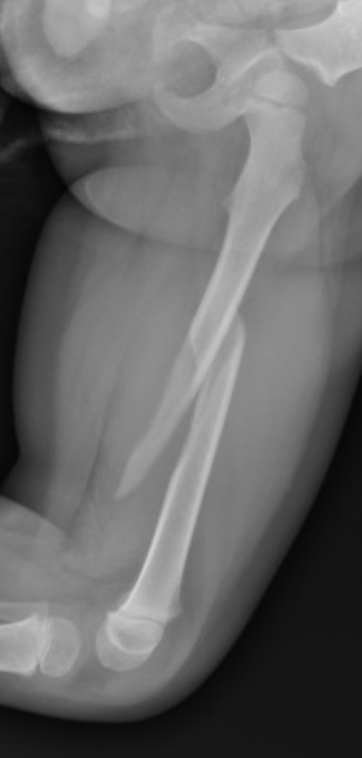
Background
Treatment decisions based on
Patient age
Patient weight/size
Fracture characteristics
Family social situation
Recent trend towards surgical intervention over closed treatment

Slide 6
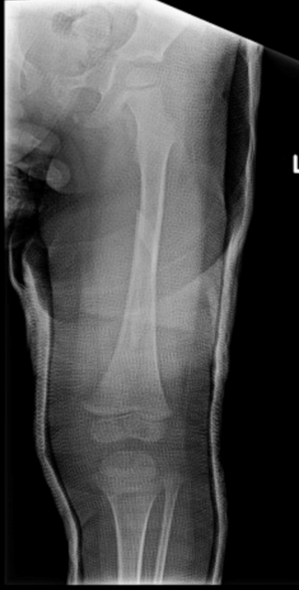
AAOS Clinical Practice Guidelines 2015
Grade A recommendation
Children aged <36 months with a diaphyseal femur fracture should be evaluated for non-accidental trauma.
Level of Evidence: II
12-14% of femur fractures in this age group are secondary to NAT
Grade B Recommendation
Treatment with early spica casting or traction with delayed spica casting for children aged 6 months to 5 years with a diaphyseal femur fracture with <2 cm of shortening.
Level of Evidence: II
Kocher MS, Sink EL, Blasier RD, Luhmann SJ, Mehlman CT, Scher DM, Matheney T, Sanders JO, Watters WC 3rd, Goldberg MJ, Keith MW, Haralson RH 3rd, Turkelson CM, Wies JL, Sluka P, Hitchcock K. Treatment of pediatric diaphyseal femur fractures. J Am Acad Orthop Surg. 2009 Nov;17(11):718-25.

Slide 7
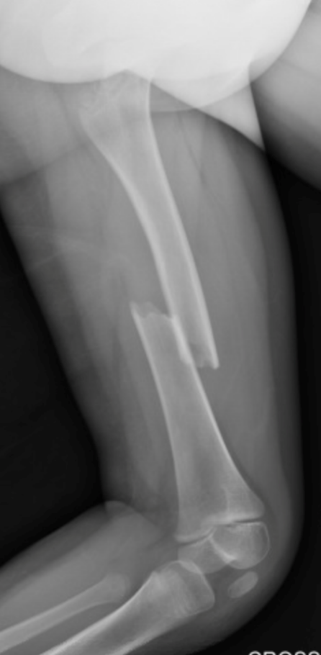
AAOS Clinical Practice Guidelines 2015
Grade C Recommendations
Treatment with a Pavlik harness or spica cast are both options for infants aged ≤6 months with a diaphyseal femur fracture.
When the spica cast is used in children aged 6 months to 5 years, you may consider altering the treatment plan when the fracture shortens >2 cm.
Waterproof cast liners for spica casts are an option for use in children diagnosed with pediatric diaphyseal femur fractures.
Kocher MS, Sink EL, Blasier RD, Luhmann SJ, Mehlman CT, Scher DM, Matheney T, Sanders JO, Watters WC 3rd, Goldberg MJ, Keith MW, Haralson RH 3rd, Turkelson CM, Wies JL, Sluka P, Hitchcock K. Treatment of pediatric diaphyseal femur fractures. J Am Acad Orthop Surg. 2009 Nov;17(11):718-25.

Slide 8
AAOS Clinical Practice Guidelines 2015
Grade C Recommendations
Flexible intramedullary nailing may be used to treat children aged 5 to 11 years with diaphyseal femur fractures.
Rigid trochanteric entry nailing, submuscular plating, and flexible intramedullary nails are treatment options for children aged 11 years to skeletal maturity with diaphyseal femur fractures but AVOID PIRIFORMIS ENTRY for rigid nailing.
Consider regional pain management for patient comfort perioperatively.
Kocher MS, Sink EL, Blasier RD, Luhmann SJ, Mehlman CT, Scher DM, Matheney T, Sanders JO, Watters WC 3rd, Goldberg MJ, Keith MW, Haralson RH 3rd, Turkelson CM, Wies JL, Sluka P, Hitchcock K. Treatment of pediatric diaphyseal femur fractures. J Am Acad Orthop Surg. 2009 Nov;17(11):718-25.

Slide 9
Treatment Algorithm
Eval for NAT
Age 0-36 months
Age ≤6 Months
Age 6 months to 5 years
Age 6 to 11 years
Age 11 years to skeletal maturity
Length stable pattern
Weight < 108 lbs (49 kg)
Length unstable pattern
Weight > 108 lbs (49 kg)
Consider if:
Damage Control
Significant Soft Tissue Injury
Vascular Injury
Pavlik Harness
Spica Casting
Flexible Nailing
Submuscular Plating
Rigid Nailing
External Fixation

Slide 10
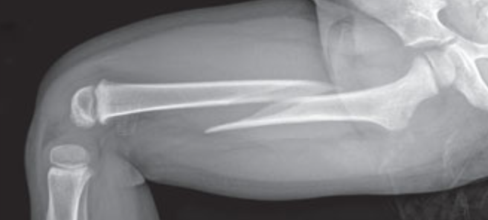
Treatment
Acceptable limits based on age
<10 year olds
15 deg of varus or valgus
20 deg of procurvatum or recurvatum
2-2.5cm shortening
Overgrowth is common in 2-10 y/o
Telescope test in higher energy trauma
(+) test→ shortening of >30mm with gentle compression
20x higher likelihood of ending with >25mm of shortening
Malrotation of 30◦
x
Notes:
Telescope test:
If intraoperative imaging is available, assess fracture stability by performing the telescope test described by Thompson et al. —i.e., by gently applying axial load to
the thigh to assess for shortening under fluoroscopic monitoring. Shortening of >3 cm reflects substantial periosteal stripping and is associated with an increased risk of loss of reduction in the cast. Alternative stabilization techniques should be considered for grossly unstable fractures with a positive telescope test. Use of intramedullary nails, external fixation, or traction with delayed cast application may decrease the risk of excessive shortening or unacceptable angulation of the fracture in the cast. (Sargent, JBJS Ess Surg Tech, 2017)

Slide 11
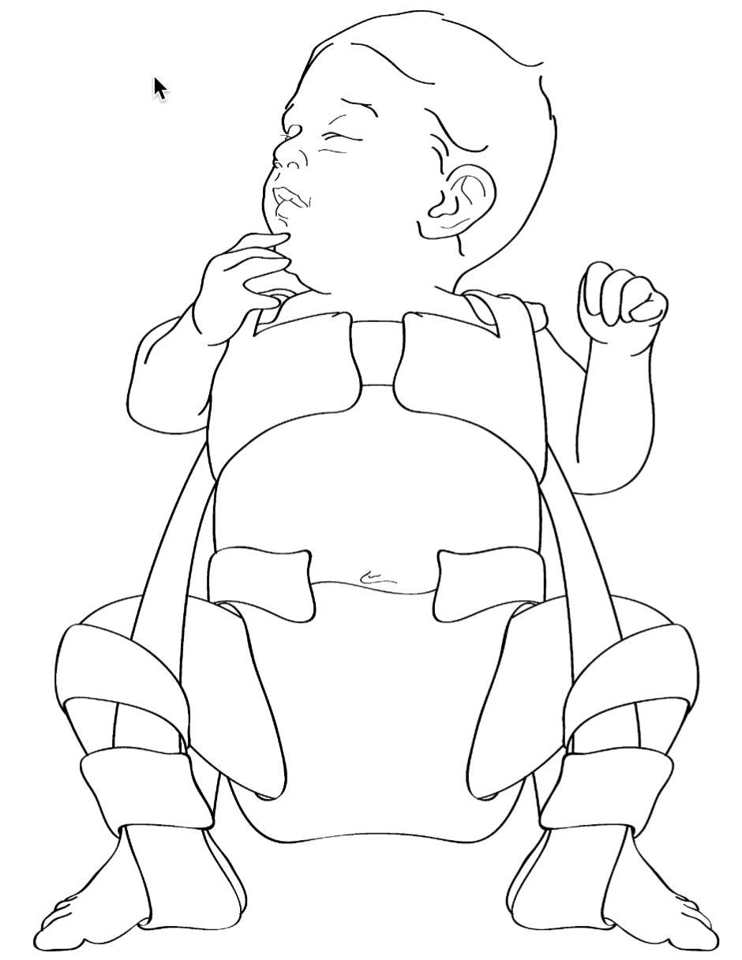
Pavlik Harness
Patients age 0-6 months
MUST Evaluate for NAT
Social services consult
Skeletal survey
Abduction ≤50◦ with pillow under leg to maintain abduction
80-90 degrees of flexion
Reduces the distal fragment to the flexed proximal fragment
Follow up at regular intervals to adjust harness
1-2 weeks to ensure harness is fitting appropriately
~4 weeks of treatment
Figure: Anglen JO, Choi L. Treatment options in pediatric femoral shaft fractures. J Orthop Trauma. 2005 Nov-Dec;19(10):724-33

Slide 12
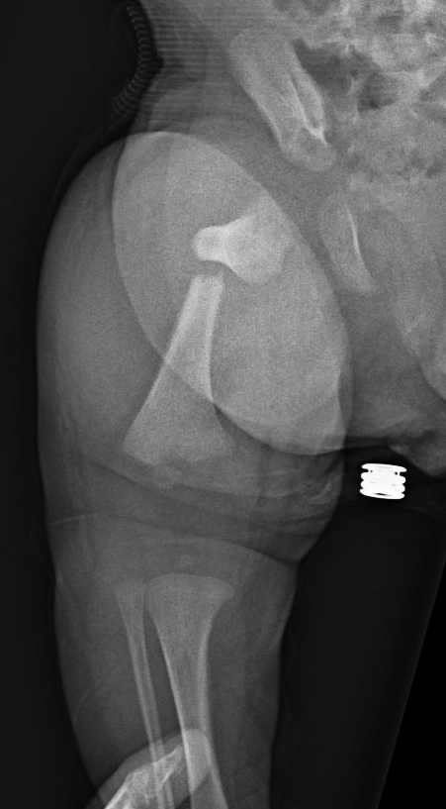
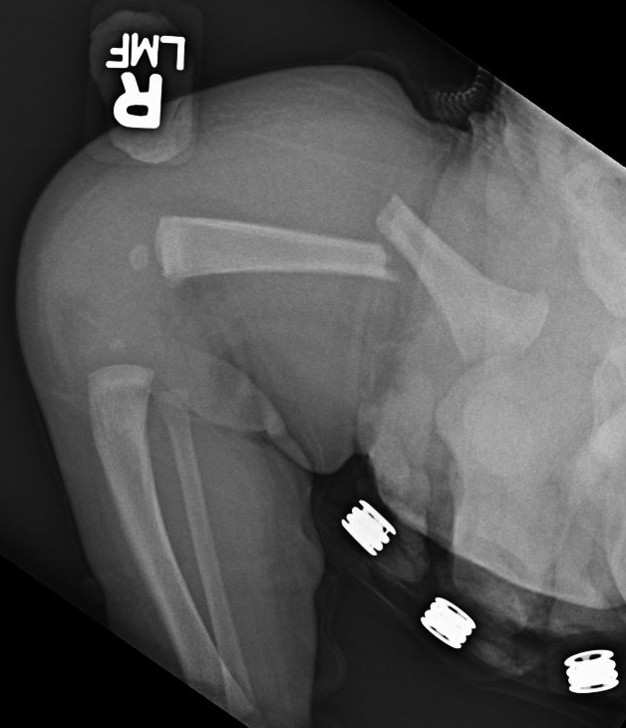
Pavlik Harness
5-week-old male
Presented to OSH with right leg swelling
Unknown mechanism
NAT workup initiated
L parietal bone fracture on skeletal survey
Treated in Pavlik harness x 4 weeks
Removed from care of mother

Slide 13
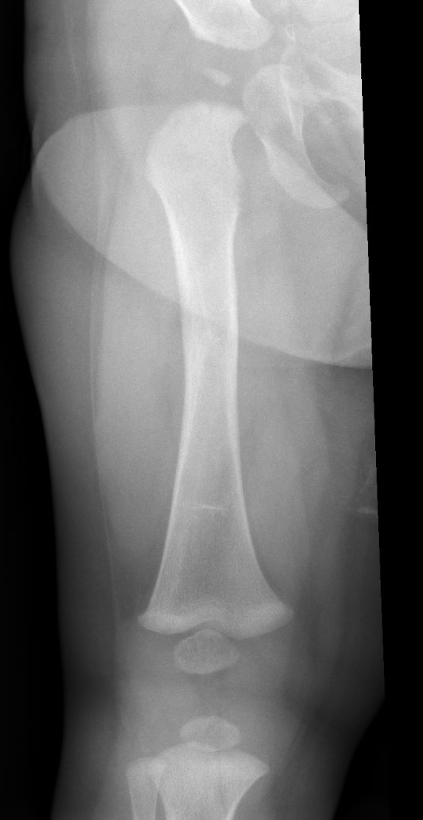
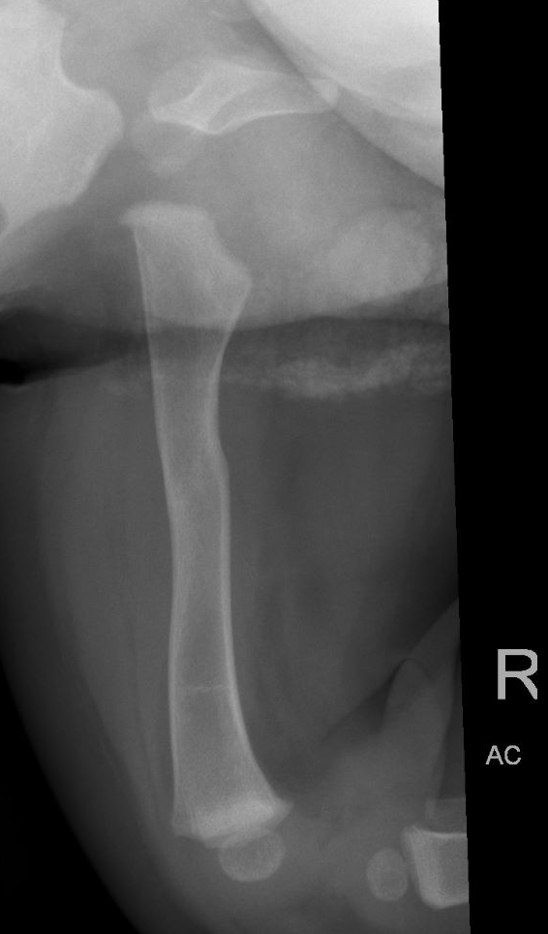
Pavlik Harness
6 months post-treatment
Completely healed and remodeled
Remains in foster care and doing well

Slide 14
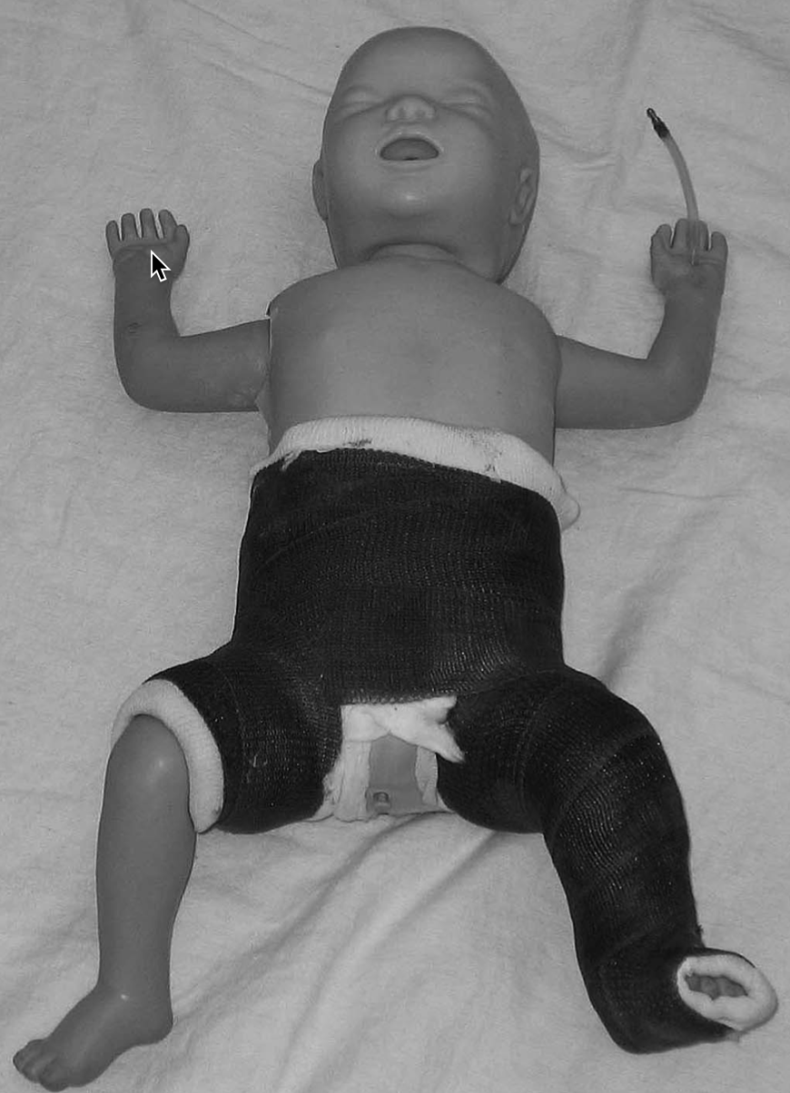
Spica Casting
Age 6 months to 5 years
Early vs delayed application acceptable
Applied in Emergency Room or Operating Room on spica table
Waterproof liners/padding available
Flex knee and hip equal amount to obtain alignment with more flexion for a more proximal fracture
Remove in 4-6 weeks when adequate callus is present
Figure: Cassinelli EH, Young B, Vogt M, Pierce MC, Deeney VF. Spica cast application in the emergency room for select pediatric femur fractures. J Orthop Trauma. 2005 Nov-Dec;19(10):709-16.

Slide 15
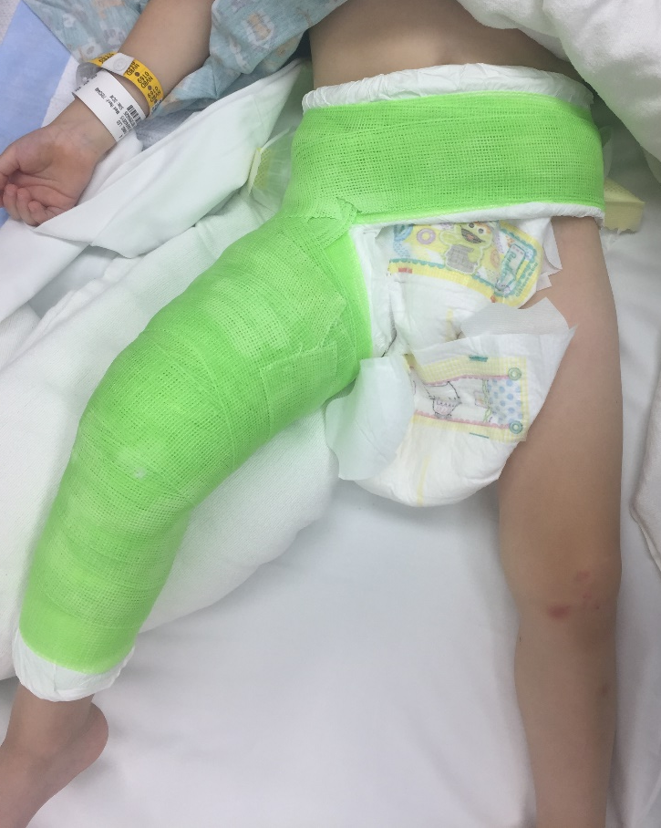
Spica Casting
Single vs Double leg
Equivalent radiographic results
Single leg spica
Parents had fewer days off work
Improved sitting in chairs
Improved sitting in car seats
Reduction typically requires a valgus mold
Acceptable angulation
15 degrees varus/valgus
20 degrees anterior/posterior
2 cm shortening
Figure: Cassinelli EH, Young B, Vogt M, Pierce MC, Deeney VF. Spica cast application in the emergency room for select pediatric femur fractures. J Orthop Trauma. 2005 Nov-Dec;19(10):709-16.
Notes:
Clinical image--CDS

Slide 16
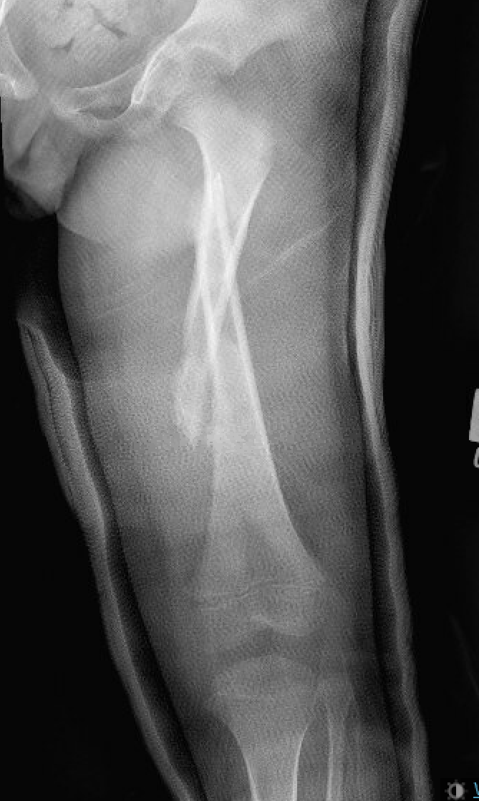
Spica Casting
Complications:
Cast complication
Shortening or malalignment of fracture
Skin breakdown or ulcerations
Tips to avoid cast complications
Keep cast well padded, especially around edges
Use waterproof liners if available
Double diaper to keep patient from soiling cast
Frequent turning to avoid pressure sores
Photos courtesy of Patrick Whitlock, MD

Slide 17
Spica Casting in ED – Keys to Success
Coordinate with ER doctors for appropriate sedation
Have two sets of “knowledgable” hands for cast application
Two residents, resident plus ortho tech/fellow/attending
Use single leg spica when possible
Make sure you have all necessary equipment available before starting procedure
C-arm
Spica table
Cast padding/liner and fiberglass laid out
Cast saw and tape for adjustments
If appropriate spica teaching and car seat not available in ER, then admit patient to floor

Slide 18
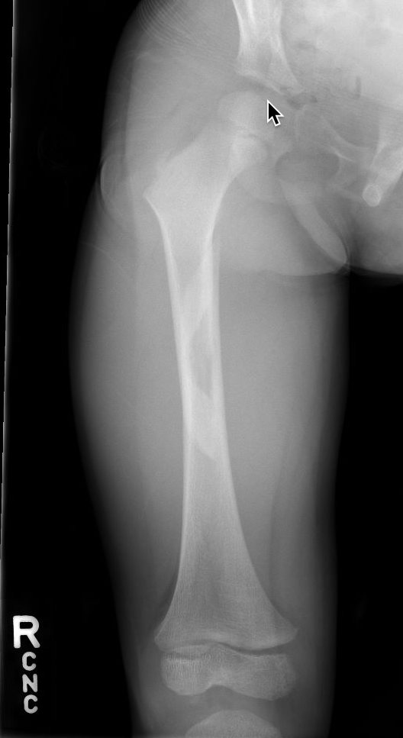
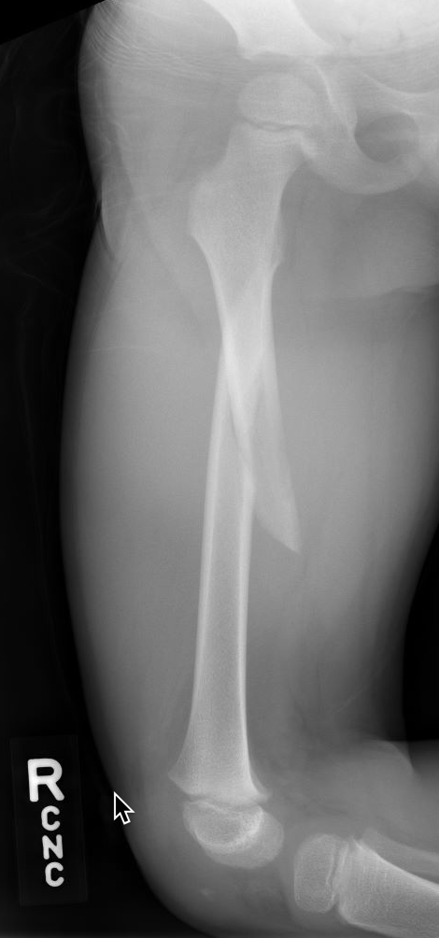
Spica Casting
3 yo M
R femoral shaft fracture
Mechanical fall while running

Slide 19
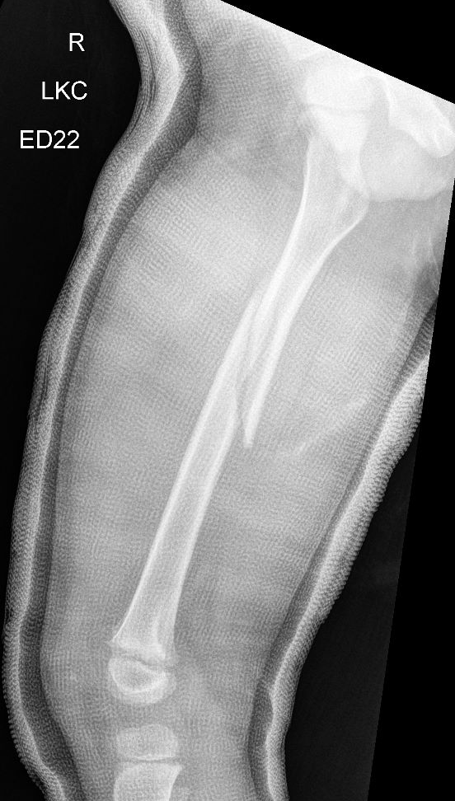
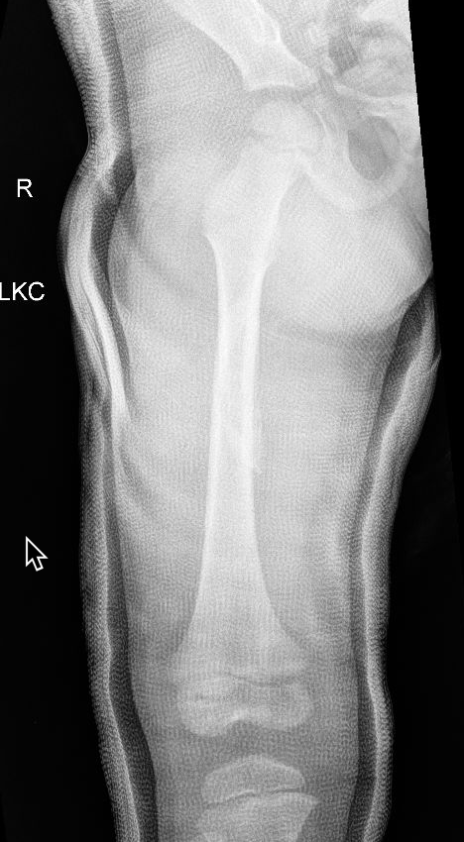
Spica Casting
Single leg hip spica applied in ER

Slide 20
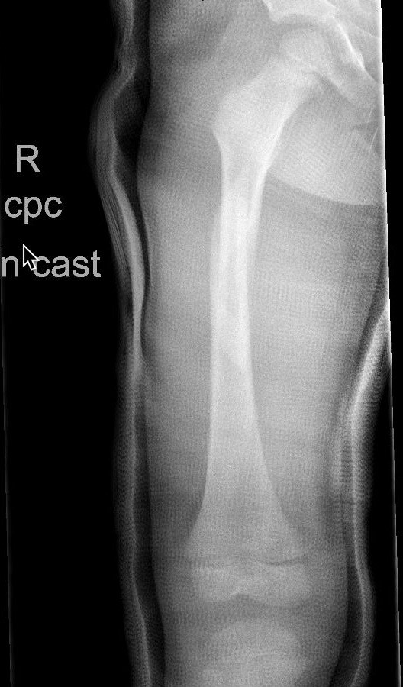
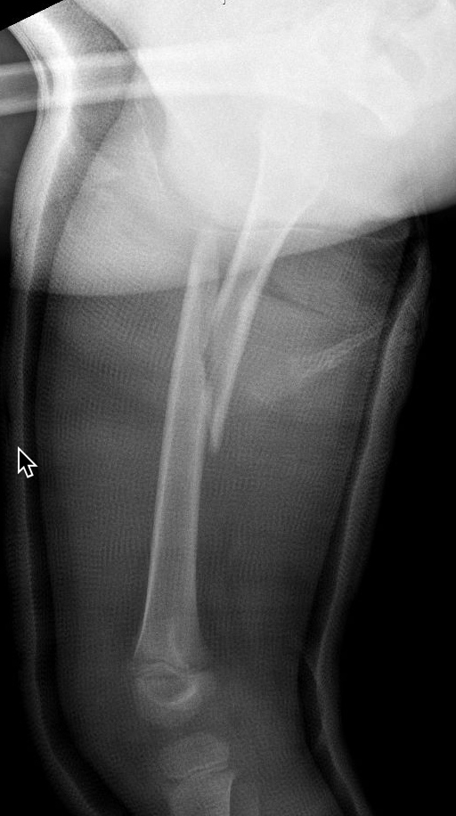
Spica Casting
1 week alignment check
Increased varus and apex anterior angulation

Slide 21
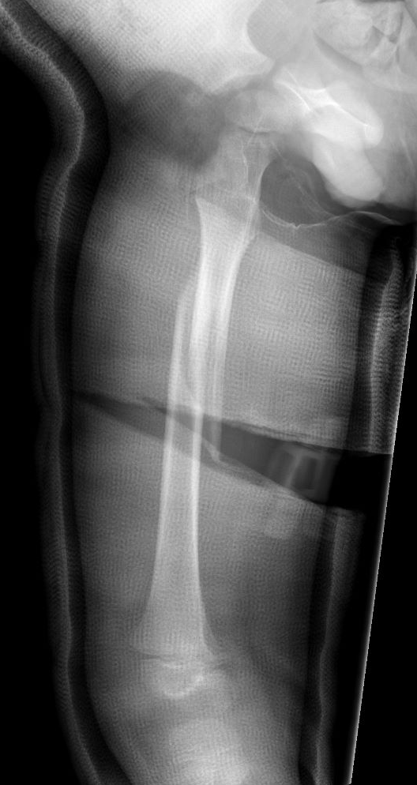
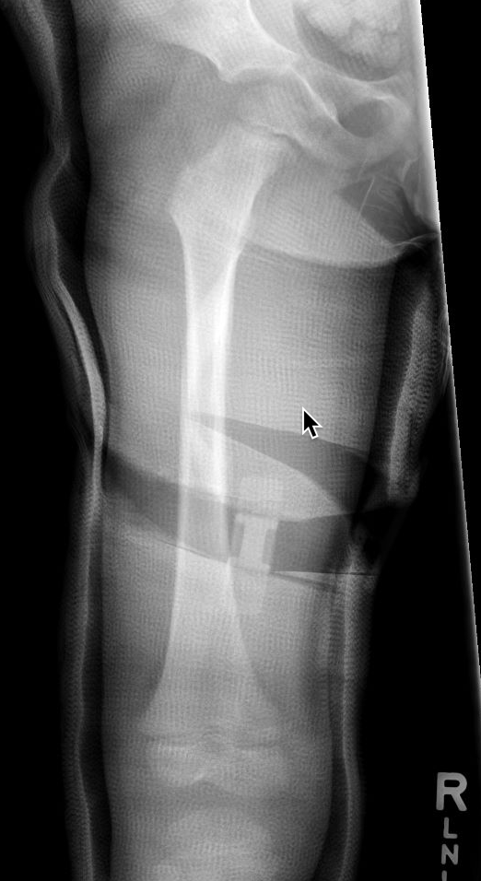
Spica Casting
Cast wedging performed in clinic
Improved alignment

Slide 22
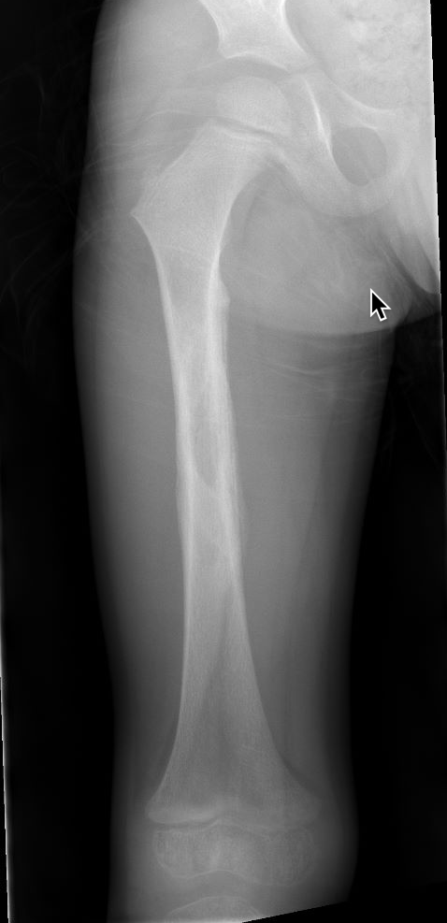
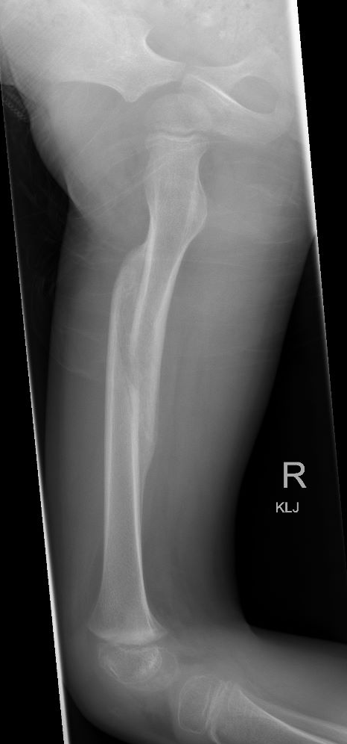
Spica Casting
Healed at 8 weeks

Slide 23
Flexible Nailing
Age 5-11 years
Length stable fractures
Complication rate increases with weight over 108 lbs (49 kg) and age >11 years
Adjunct bracing, casting or prolonged immobilization in heavier, older patients
Can consider in length unstable fractures, proximal and distal fractures depending on surgeon preference and expertise

Slide 24
Flexible Nailing
Radiolucent table or fracture table
Starting point for retrograde nails is the metaphyseal diaphyseal junction
Aim for combined nail diameter 80% canal fill
d
$$Nail Diameter=\frac{d×80\%}{2}$$
Wall, Eric J., et al. "Complications of titanium and stainless steel elastic nail fixation of pediatric femoral fractures." JBJS90.6 (2008): 1305-1313.

Slide 25
Flexible Nailing
Stainless steel vs. titanium nails
Stainless steel has higher stiffness/modulus of elasticity
Titanium better biomechanical stability in axial compression and torsion
Stainless steel less expensive
Clinical outcomes improved with stainless steel
Decreased rate of malunion
Decreased rate of major complications
d
$$Nail Diameter=\frac{d×80\%}{2}$$
Wall, Eric J., et al. "Complications of titanium and stainless steel elastic nail fixation of pediatric femoral fractures." JBJS90.6 (2008): 1305-1313.

Slide 26
Flexible Nailing
Techniques
Retrograde medial and lateral
Most common technique
2 ‘C-shaped’ nails

Slide 27
Flexible Nailing
Techniques
Retrograde all lateral
Possibly quicker procedure
1 ‘C-shaped’ & 1 ‘S-shaped’ nail

Slide 28
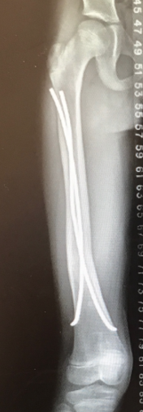
Flexible Nailing
Techniques
Antegrade
Consider for distal fractures or distal soft tissue wounds
1 ‘C-shaped’ & 1 ‘S-shaped’ nail

Slide 29
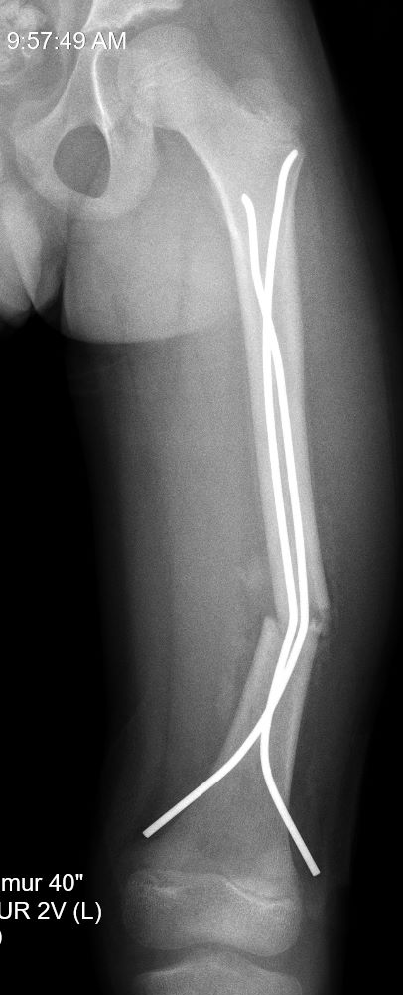
Flexible Nailing
Complications
Shortening
Nail irritation requiring revision surgery
Infection
Delayed union
Hardware failure
Tips to prevent complications:
Add supplemental immobilization
Casting or bracing
Weight bearing restrictions until healing on x-rays (4-6 weeks)

Slide 30
Flexible nailing
Length unstable fractures
Comminuted
Long oblique fractures
Shortening can result with standard ESIN techniques
Alternatives
Supplemental single leg spica cast x 4 weeks
Locked Enders nail
End caps on titanium flex nails

Slide 31
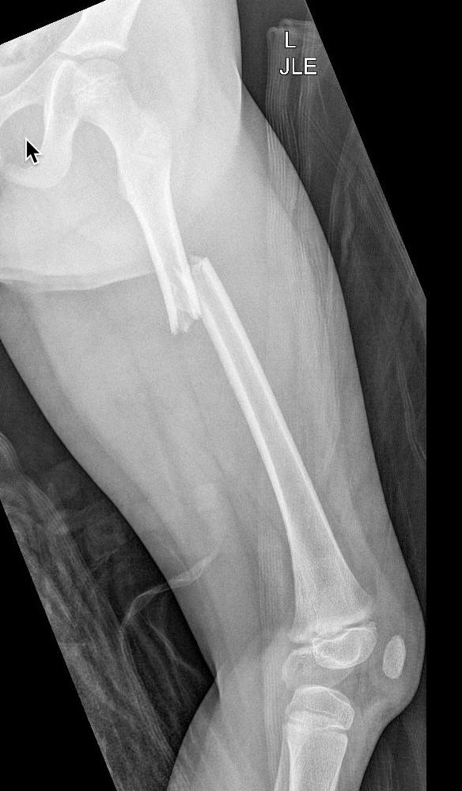
Flexible Nailing
6 yo Female
44 lbs (20 kg)
Pedestrian struck by motor vehicle
Injuries:
Bilateral pulmonary contusions and pneumothoraces
Bilateral rib fractures
L diaphyseal femur fracture

Slide 32
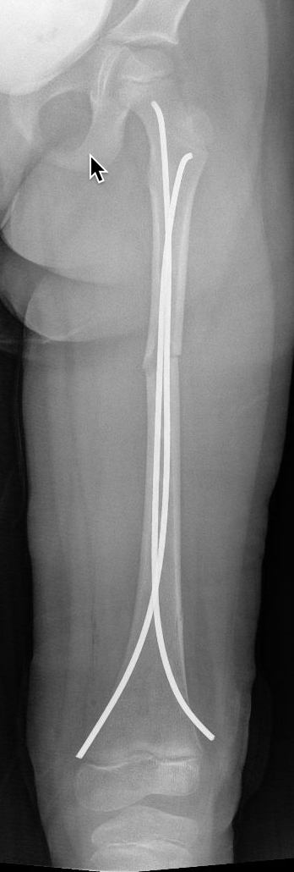
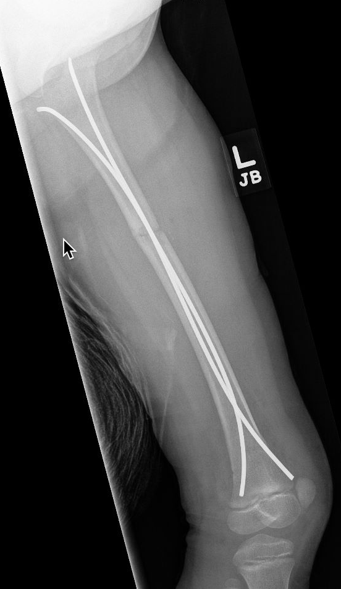
Flexible Nailing
Flat Jackson table
Nail size chosen based on 80% canal fill
NWB until 4 weeks post-op
d
$$Nail Diameter=\frac{d×80\%}{2}$$

Slide 33
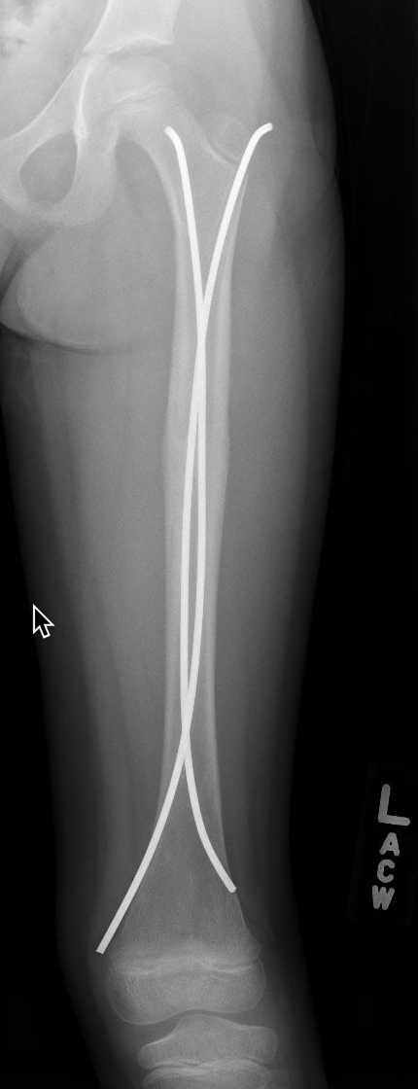
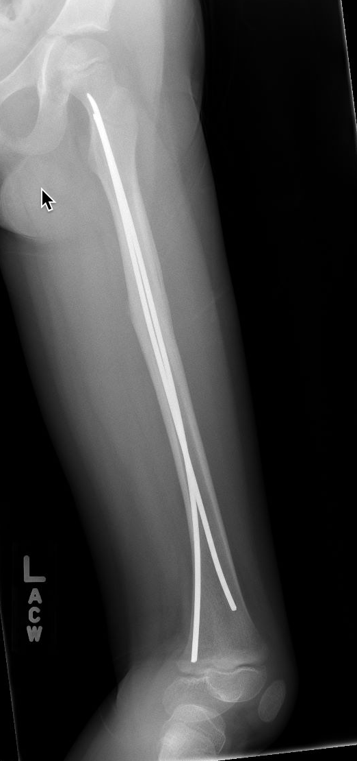
Flexible Nailing
5 months post-op

Slide 34
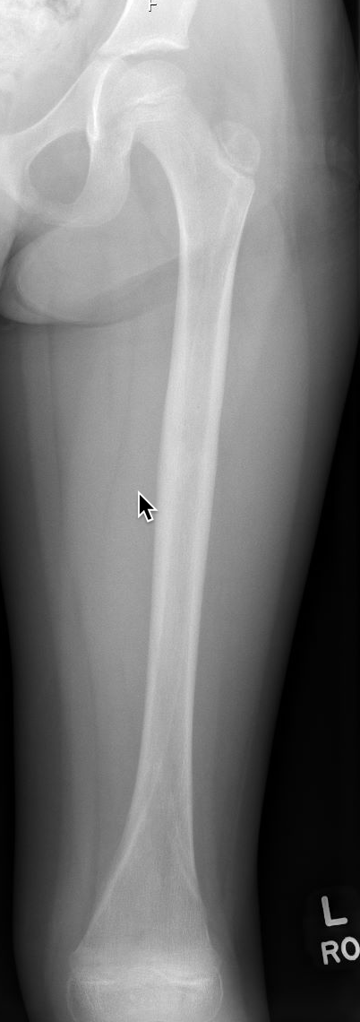
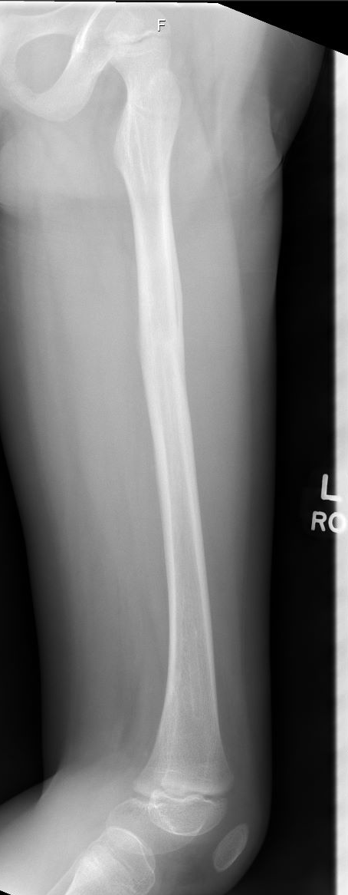
Flexible Nailing
Removal of hardware at 7 months post-op
Timing of removal varies
4-6 months
Complete healing of fracture
4 cortices
Limit impact activities for at least 4 weeks post-op

Slide 35
Submuscular Plating
Age 5 through skeletal maturity
Length unstable fractures
Comminuted
Spiral
Shortened > 2 cm
Internal splint
Preserves endosteal and periosteal blood supply around fracture site
Figure: Hedequist DJ, Sink E. Technical aspects of bridge plating for pediatric femur fractures. J Orthop Trauma. 2005 Apr;19(4):276-9.

Slide 36
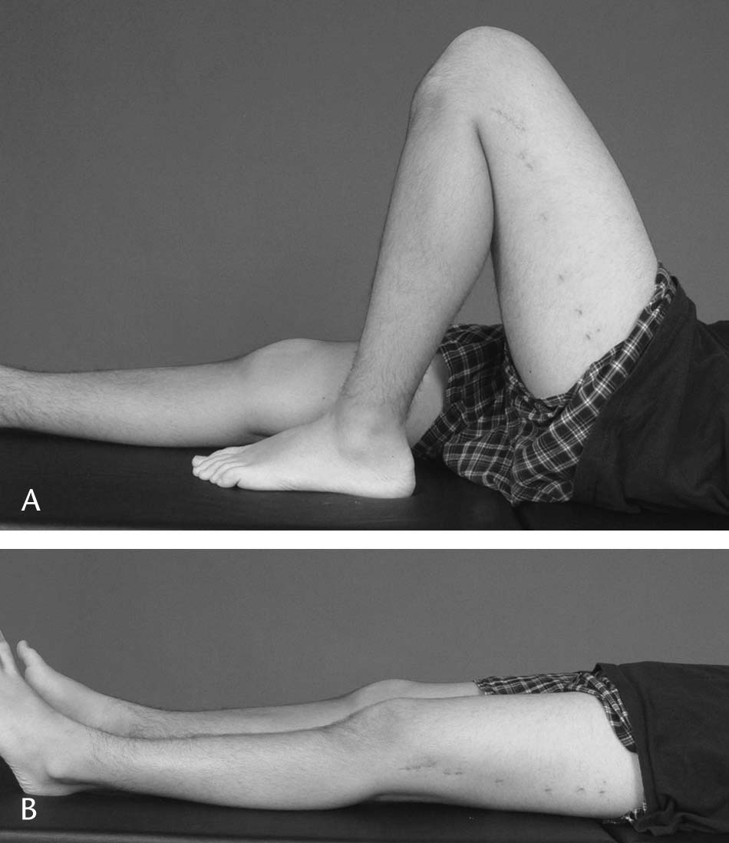
Submuscular Plating
Supine
Radiolucent table vs fracture table
3.5 mm or 4.5 mm plates available
Bicortical non-locking screws
Minimally invasive
Insert through incisions – proximal and distal
Slide plate retrograde along femur between the incisions
Typically non-weight bearing post-operatively
Hardware removal between 6-12 months
Figure: Hedequist DJ, Sink E. Technical aspects of bridge plating for pediatric femur fractures. J Orthop Trauma. 2005 Apr;19(4):276-9.

Slide 37
Submuscular Plating
Complications
Infection
Bony overgrowth
Distal femoral valgus
Hardware failure
Symptomatic hardware
Malunion
Figure: Hedequist DJ, Sink E. Technical aspects of bridge plating for pediatric femur fractures. J Orthop Trauma. 2005 Apr;19(4):276-9.

Slide 38
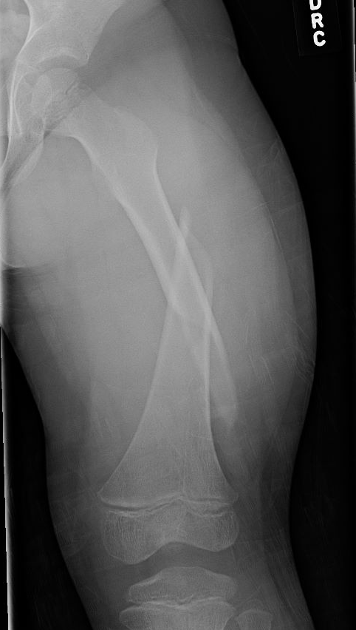
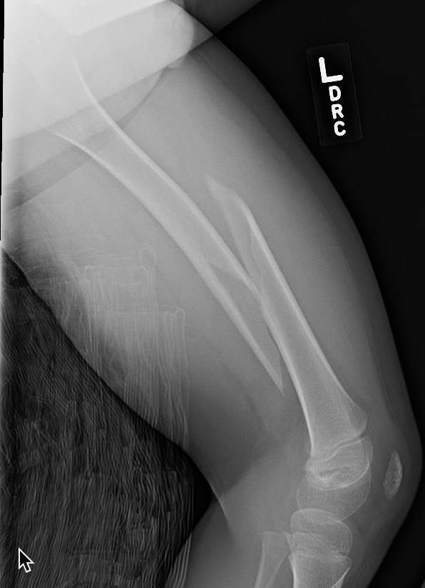
Submuscular Plating
6-year-old male
28 kg
L femur fracture sustained during rough housing/wrestling

Slide 39
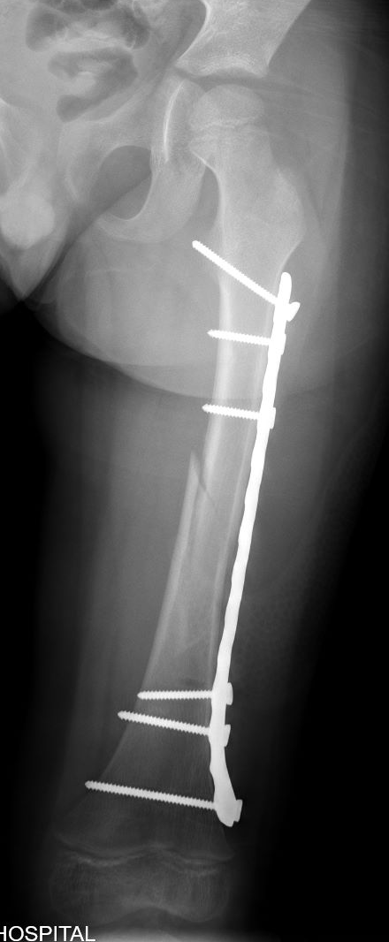
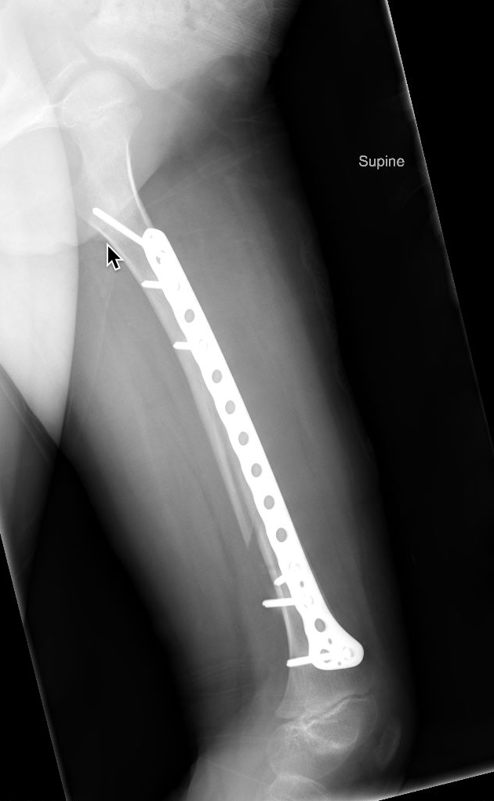
Submuscular Plating
Flat Jackson radiolucent table
Distal and proximal incisions
Slide plate under the vastus lateralis along the bone with indirect reduction of femur
Tip: Keep plate at least 1 cm proximal to the distal femoral physis
prevent damage to growth plate and distal femoral valgus

Slide 40
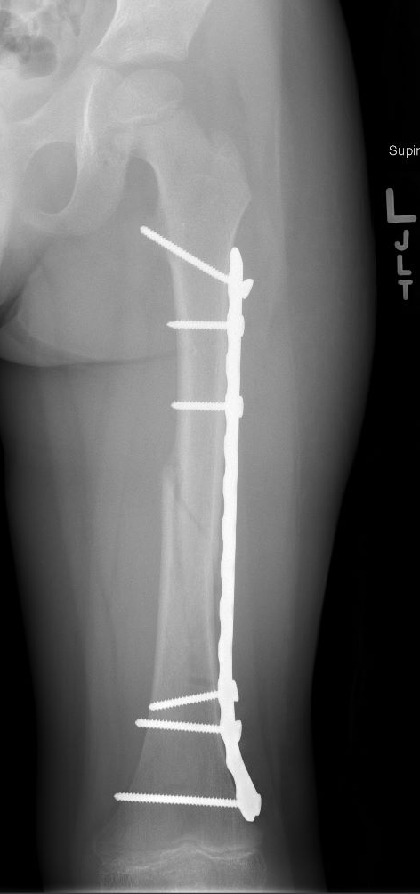
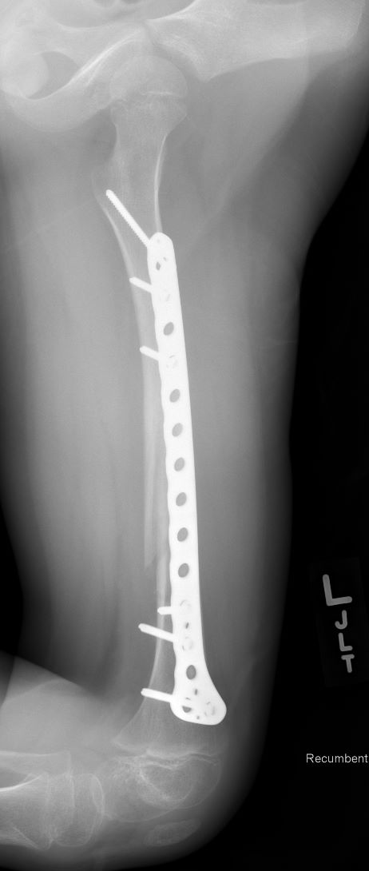
Submuscular Plating
6 weeks post-op
NWB until now
Advance to progressive weight bearing
X-rays show some healing/callus formation and patient without pain at fracture site

Slide 41
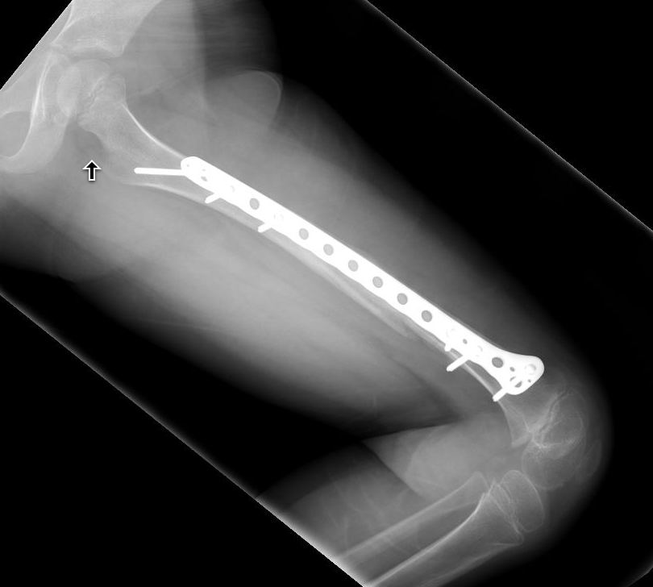
Submuscular Plating
3 months post-op
Participating in PT
Ambulating without a limp
Resumed normal activities

Slide 42
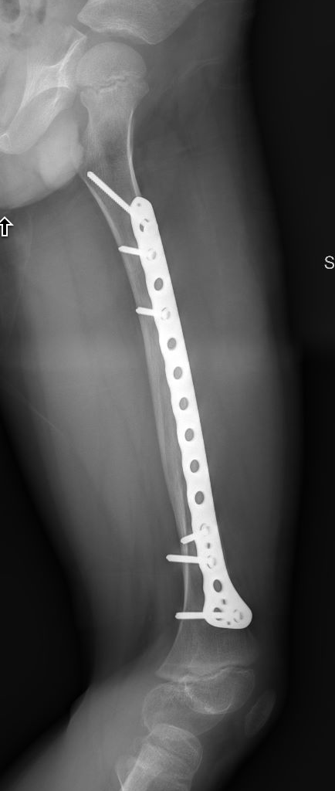
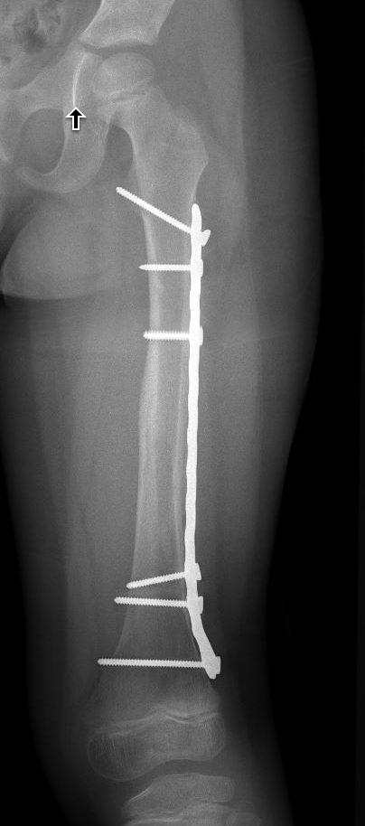
Submuscular Plating
5 months post-op
Completed PT
Ambulating without a limp and back to normal activities

Slide 43
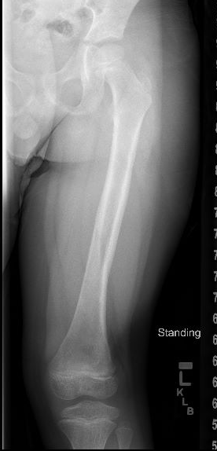
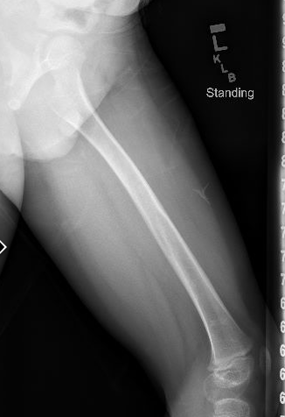
Submuscular Plating
Removal of hardware at 6 months post-op
Mild valgus alignment at distal femur
No impact activities for 4 weeks post-operatively

Slide 44
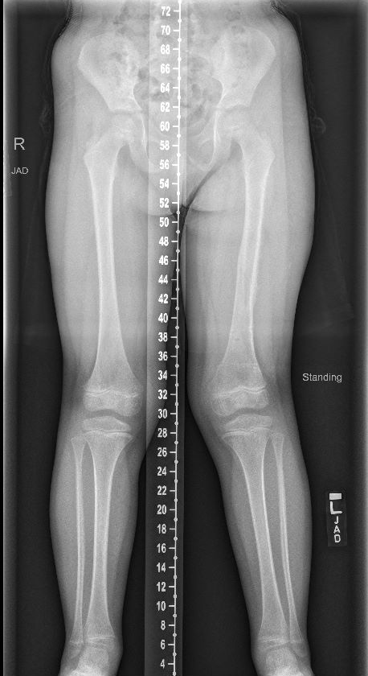
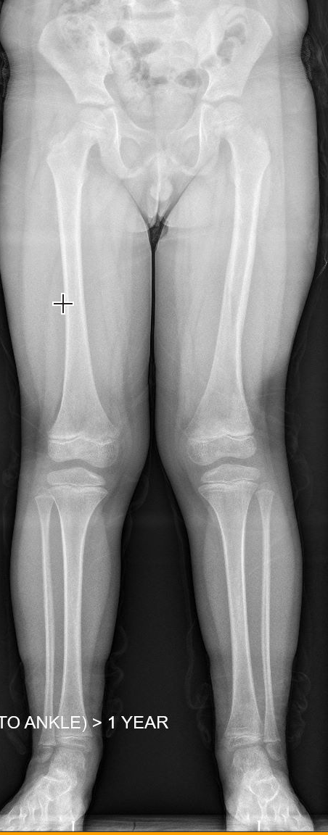
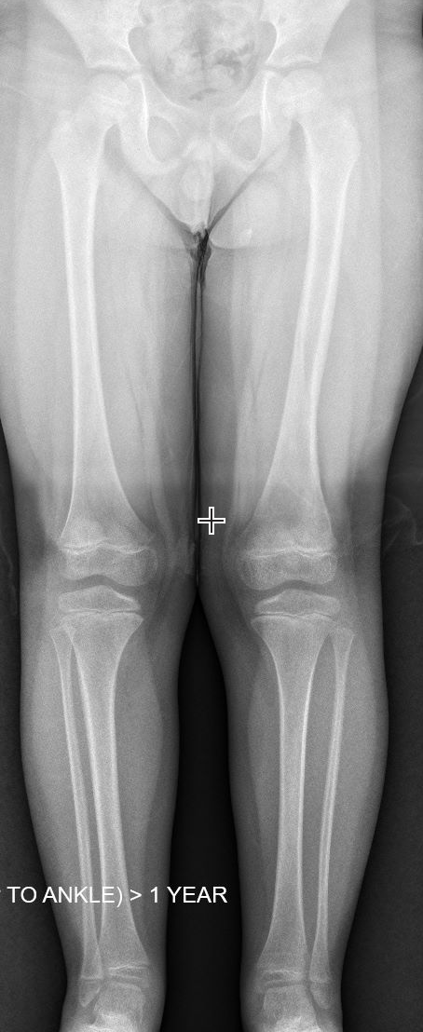
Submuscular Plating
Distal femoral valgus can occur following submuscular plating
6 months post-op
10 months post-op
17 months post-op
Resolved without treatment

Slide 45
Rigid Nailing
Age 11 through skeletal maturity
Weight > 108 lbs (49 kg)
Appropriate for length unstable, comminuted, oblique, proximal or distal fractures
Avoid Piriformis entry nails
Increased risk of AVN
Lateral entry antegrade nails preferred

Slide 46
Rigid Nailing – Patient Positioning
Surgeon preference plays a large role in choice
Supine
Easy to position
Easy to administer anesthesia
Able to identify rotational malalignment
Fracture table
Allows for fewer assistants
May increase risk of compartment syndrome in well leg
Difficult to identify rotational malalignment
Lateral decubitus
Improved access to lateral starting point, particularly in obese patient
Access limb from both sides
Easier lateral imaging of proximal femur

Slide 47
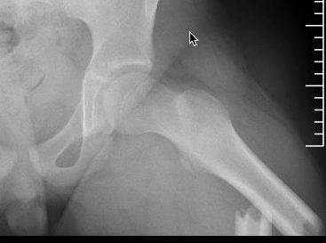
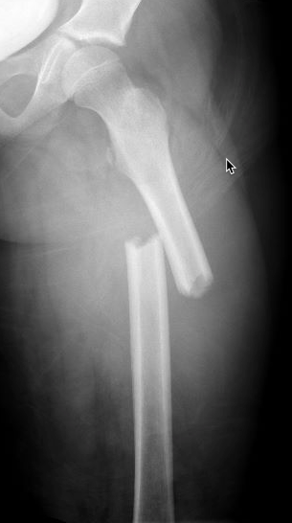
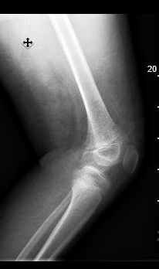
Rigid Nailing
10-year-old male
80 kg (176 lbs)
ATV rollover
Isolated L diaphyseal femur fracture
Flex nails?
Too heavy
Plating vs rigid (IMN) nailing
Immediate weight bearing with IMN
Possible growth arrest of greater trochanter and AVN with IMN

Slide 48
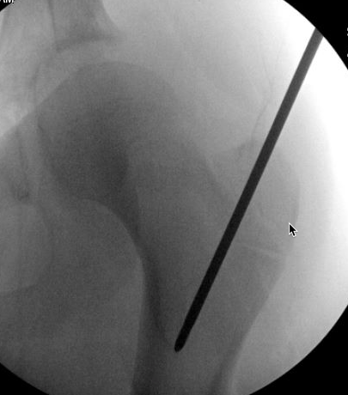
Rigid Nailing
Fracture table
Adolescent lateral entry nail
AVOID piriformis starting point

Slide 49
Rigid Nailing
4 weeks post-op
Ambulating without crutches
Still using wheelchair for long distances/school
No pain medications
Weight bearing immediately post-op

Slide 50
Rigid Nailing
8 weeks post-op
Ambulating without a limp

Slide 51
Rigid Nailing
16 weeks post-op
Has returned to regular activities
No pain
Will plan for hardware removal given age and remaining growth

Slide 52
External Fixation
Fracture through chronic osteomyelitis
Length unstable fracture
Temporary stabilization if patient too unstable for definitive fixation
Useful in cases of pathologic fractures and infection
Allows access to large soft tissue injury for wound care

Slide 53
External Fixation
Fracture through chronic osteomyelitis
Length unstable fracture
Convert to internal fixation within 2 weeks
Reduced risk of infection
May use as definitive treatment if necessary
Risk of pin tract infections
Risk of refracture after removal
At fracture site or pin sites

Slide 54
Special Circumstances
9 yo M
Subtrochanteric fractures
12% of all femur fractures
Large deforming forces
Short proximal segment in flexion (psoas), abduction (gluteal muscles) and external rotation (short external rotators)
Can use spica, flex nails, plate or locked IMN to treat depending on age group
5 months
3 yo F
Time of Injury
3 months
2 years

Slide 55
Special Circumstances
Distal femoral shaft fractures
Close proximity to distal femoral physis
Short distal segment
May need to temporarily span the physis
Monitor for growth arrest over time
Treatment options
CRPP
ORIF – try to stay 1 cm proximal to physis
3.5/4.5 plates
Distal femoral metaphyseal plates
Retrograde nail if physis is closed/closing

Slide 56
Complications
6w after exchange IMN
Can occur with all treatment modalities
Leg length discrepancy
Shortening
Overgrowth
Unknown mechanism – activation of growth plate, fracture site instability, disrupted periosteum
Average 10.5 +/- 7.3 mm for 87 femur fractures treated with elastic nails or plating*
No fractures with > 2 cm overgrowth
Infection
Nonunion
Exchange nail
Revision ORIF + bone graft
*Park KH, Park BK, Oh CW, Kim DW, Park H, Park KB. Overgrowth of the Femur After Internal Fixation in Children With Femoral Shaft Fracture-A Multicenter Study. J Orthop Trauma. 2020 Mar;34(3):e90-e95.

Slide 57
Complications
Malunion
Varus and flexion most common
Remodeling is greatest in sagittal plane
Malrotation
Rotational deformity does not remodel
Multiple techniques exist to determine rotational deformity intraoperatively for comminuted fractures
True Lateral Technique (Tornetta 1995)
Lesser Trochanter Profile
Gordon JE, Mehlman CT. The Community Orthopaedic Surgeon Taking Trauma Call: Pediatric Femoral Shaft Fracture Pearls and Pitfalls. J Orthop Trauma. 2017 Nov;31 Suppl 6:S16-S21.

Slide 58
Treatment Algorithm
Eval for NAT
Age 0-36 months
Age ≤6 Months
Age 6 months to 5 years
Age 6 to 11 years
Age 11 years to skeletal maturity
Length stable pattern
Weight < 108 lbs (49 kg)
Length unstable pattern
Weight > 108 lbs (49 kg)
Consider if:
Damage Control
Significant Soft Tissue Injury
Vascular Injury
Pavlik Harness
Spica Casting
Flexible Nailing
Submuscular Plating
Rigid Nailing
External Fixation

Slide 59
Summary
Treatment of pediatric diaphyseal femur fractures is based on patient age, weight/size, fracture characteristics and family social situation.
NAT should always be considered in patients under 36 months of age.
Options include Pavlik harness, spica casting, flexible nailing, submuscular plating, rigid nailing and external fixation.
Each treatment option has its own set of technical challenges and possible complications to consider.

Slide 60
References
Anglen JO, Choi L. Treatment options in pediatric femoral shaft fractures. J Orthop Trauma. 2005 Nov-Dec;19(10):724-33. doi: 10.1097/01.bot.0000192294.47047.99. PMID: 16314721.
Cassinelli EH, Young B, Vogt M, Pierce MC, Deeney VF. Spica cast application in the emergency room for select pediatric femur fractures. J Orthop Trauma. 2005 Nov-Dec;19(10):709-16. doi: 10.1097/01.bot.0000184146.82824.35. PMID: 16314719.
Gordon JE, Mehlman CT. The Community Orthopaedic Surgeon Taking Trauma Call: Pediatric Femoral Shaft Fracture Pearls and Pitfalls. J Orthop Trauma. 2017 Nov;31 Suppl 6:S16-S21.
Hedequist DJ, Sink E. Technical aspects of bridge plating for pediatric femur fractures. J Orthop Trauma. 2005 Apr;19(4):276-9. doi: 10.1097/01.bot.0000142324.59313.50. PMID: 15795577.
Herrera-Soto JA, Meuret R, Phillips JH, Vogel DJ. The management of pediatric subtrochanteric femur fractures with a statically locked intramedullary nail. J Orthop Trauma. 2015 Jan;29(1):e7-e11.
Hosalkar HS, Pandya NK, Cho RH, Glaser DA, Moor MA, Herman MJ. Intramedullary nailing of pediatric femoral shaft fracture. J Am Acad Orthop Surg. 2011 Aug;19(8):472-81. doi: 10.5435/00124635-201108000-00003. PMID: 21807915.
Kocher MS, Sink EL, Blasier RD, Luhmann SJ, Mehlman CT, Scher DM, Matheney T, Sanders JO, Watters WC 3rd, Goldberg MJ, Keith MW, Haralson RH 3rd, Turkelson CM, Wies JL, Sluka P, Hitchcock K. Treatment of pediatric diaphyseal femur fractures. J Am Acad Orthop Surg. 2009 Nov;17(11):718-25. doi: 10.5435/00124635-200911000-00006. PMID: 19880682.
Leu D, Sargent MC, Ain MC, Leet AI, Tis JE, Sponseller PD. Spica casting for pediatric femoral fractures: a prospective, randomized controlled study of single-leg versus double-leg spica casts. J Bone Joint Surg Am. 2012 Jul 18;94(14):1259-64. doi: 10.2106/JBJS.K.00966. PMID: 22695973.
Marchand LS, Jacobson LG, Stuart AR, Haller JM, Higgins TF, Rothberg DL. Assessing Femoral Rotation: A Survey Comparison of Techniques. J Orthop Trauma. 2020 Mar;34(3):e96-e101.
Park KH, Park BK, Oh CW, Kim DW, Park H, Park KB. Overgrowth of the Femur After Internal Fixation in Children With Femoral Shaft Fracture-A Multicenter Study. J Orthop Trauma. 2020 Mar;34(3):e90-e95.
Rush JK, Kelly DM, Sawyer JR, Beaty JH, Warner WC Jr. Treatment of pediatric femur fractures with the Pavlik harness: multiyear clinical and radiographic outcomes. J Pediatr Orthop. 2013 Sep;33(6):614-7. doi: 10.1097/BPO.0b013e318292464a. PMID: 23774204.
Sargent MC. Single-Leg Spica Cast Application for Treatment of Pediatric Femoral Fracture. JBJS Essent Surg Tech. 2017 Sep 13;7(3):e26.
Sutphen SA, Beebe AC, Klingele KE. Bridge Plating Length-Unstable Pediatric Femoral Shaft Fractures. J Pediatr Orthop. 2016 Jun;36 Suppl 1:S29-34. doi: 10.1097/BPO.0000000000000761. PMID: 27078229.

